Slide 1
Why Are Different Places Similar
Focus Questions 1-3-2/1-3-4
Aside from Globalization what three elements of space do Geographers focus on in order to understand why different places are similar?
In regards to the distribution of features what key properties do Geographers specifically study to understand the distribution across Earth?
What are the three main distributions Geographers study in order to understand how people sort themselves out in space and move across the landscape?
Geographers take a range of approaches to understanding cultural identity, space and inequality. What are the five areas Geographers study in order to understand the experience of people.

Slide 2
Why Are Different Places Similar?
Aside from Globalization Spatial Thinking helps Geographers understand why different places may be similar.
Geographers think about the arrangement of people, activities found in each space and try to understand why those people and activities are distributed across space as they are.
Distribution of Features, Cultural Identity and Inequality all help Geographers understand the similarities of spaces at a greater depth.
1. Space: Distribution of Features
Space refers to the physical gap or interval between two objects.
Geographers look at distribution. Which is the arrangement of a feature in space.

Slide 3
Why Are Different Places Similar?
1. Space: Distribution of Features cont...
Geographers identify three main properties of distribution across Earth:
Density- frequency with which something occurs in space (Trees, cars, houses, people) Any measurement of space can be used (miles, Kilometers etc.)
Concentration- extent of a feature spread over space (Not the same as Density)
Closely spaced together is known as clustered.
Relatively far apart is known as dispersed.
Pattern- geometric arrangement of objects in space

Slide 4
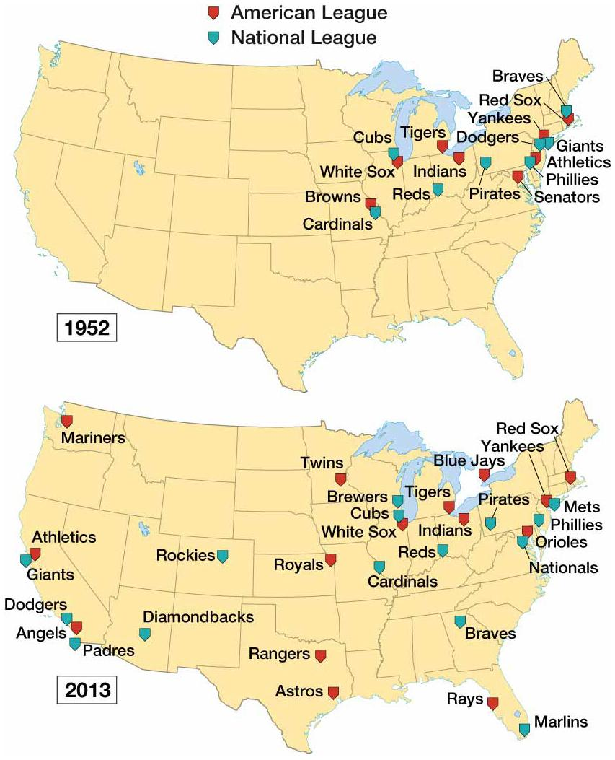
Density versus Concentration
Greater Concentration
Greater Density
Notes:
FIGURE 1-11 TIME ZONES The United States and Canada share four standard time zones:
• Eastern, near 75° west, is 5 hours earlier than GMT.
• Central, near 90° west, is 6 hours earlier than GMT.
• Mountain, near 105° west, is 7 hours earlier than GMT.
• Pacific, near 120° west, is 8 hours earlier than GMT.
The United States has two additional standard time zones:
• Alaska, near 135° west, is 9 hours earlier than GMT.
• Hawaii-Aleutian, near 150° west, is 10 hours earlier than GMT.
Canada has two additional standard time zones:
• Atlantic, near 60° west, is 4 hours earlier than GMT.
• Newfoundland is 3½ hours earlier than GMT; the residents of Newfoundland assert that their island, which lies between 53° and 59° west longitude, would face dark winter afternoons if it were in the Atlantic Time Zone and dark winter mornings if it were 3 hours earlier than GMT.
4

Slide 5
Why Are Different Places Similar?
2. Space: Cultural Identity
Patterns in space vary according to gender, ethnicity and sexuality.
Geographers study these cultural traits because they are important in explaining why people sort themselves out in space and move across the landscape.
1. Distribution of By Ethnicity:
Helps understand how and why
humans organize in certain spaces.
2. Distribution By Sexual Orientation:
Openly gay, lesbian, bisexual and
transgender (LGBT) locate to reinforce
spatial interaction with other LGBT people.
(San Francisco, Palm Springs)

Slide 6
Why Are Different Places Similar?
2. Space: Cultural Identity
3. Distribution of Gender: the distribution of women does not vary across space like ethnicity and sexual orientation. To help with gender geographers focus on inequality as a primary factor in understanding gender distribution.
Income 2. Rights 3. Equality
-Large gaps in income, rights and equality in many countries.
-The United Nations has not found a single country in the world where the average income earned by a women exceeds that earned by men.

Slide 7
Why Are Different Places Similar?
3. Space: Inequality: Helps Geographers understand the experience of people.
Geographers take a range of approaches to understanding cultural identity, space and inequality.
Poststructuralist Geography: examines how the powerful in society dominate or seek control over less powerful groups of people. It also looks at how the dominated groups occupy space and confrontations.
Humanistic Geography: emphasizes the different ways that individuals form ideas about place and give those places symbolic meanings. (Arenas Rd, Friendly to LGBT because its safe) Chinatown in LA.
Behavioral Geography: emphasizes the importance of understanding the psychological basis for individual human actions in space.
Ex: Husband gets in the car drives to work, spends all day working and then heads home. The Wife which now works outside the home drives the kids to school, then works, picks the kids up from school and then grocery shops before heading home.

Slide 8
Why Are Different Places Similar?
3. Space: Inequality
4. Unequal Access: Physical barriers, such as oceans and deserts, can still disrupt interaction among people. In the modern world barriers to interaction are more likely be caused from unequal access to electronics.
Electronic services varies among places
Internet access depends on availability of electricity
Broadband services requires proximity to digital subscribers
Affordability to such products and infrastructure.
North America, Europe, and Japan hold the most advanced technology and capital to invest. Africa, Latin America and Asia find themselves behind in those areas.
5. Uneven development; increasing gap in economic conditions between regions.

