Slide 1
APHUG Chapter 2
Review Population and Helath

Slide 2
Chapter 2 Review
What are the four major regions where the highest clusters of population are found?
What are the three ways in which density is measured? What does each one measure?
Why do geographers use population pyramids?
What methods are used to help slow population growth?

Slide 3
Population Concentrations
Population Concentrations
Human beings are not distributed uniformly across Earth. Geographers understand how population is distributed by examining two basic properties. Concentration and Density.
Geographers identify regions of Earth’s surface where population is clustered and regions where its sparse.
A census of population helps determine the number of people and it’s a tool often used by Geographers. (Not always reliable or accurate, Political, fear, not inclusive)
Four Major Clusters
• 2/3 of the world’s inhabitants are clustered in four regions.
• East Asia • South Asia • Southeast Asia • Europe
They all display differences in the pattern of occupancy of the land
Site and Situation of Population Clusters
• Low-lying areas with fertile soil and temperate climate
• Near an ocean or near a river with easy access to an ocean.

Slide 4
Population Concentrations
Europe
Includes four dozen countries, ranging from Monaco, with 1 square kilometer (0.7 square miles) and a population of 33,000, to Russia, the world's largest country in land area when its Asian part is included.
In contrast to the three Asian concentrations, ¾ of Europe's inhabitants live in cities, and fewer than 10 percent are farmers.
The highest population concentrations in Europe are near the major rivers and coalfields of Germany and Belgium, as well as historic capital cities such as London and Paris.
East Asia
Nearly one-fourth of the world’s people live in East Asia. The region, bordering the Pacific Ocean, includes eastern China, the islands of Japan, the Korean peninsula, and the island of Taiwan.
The People’s Republic of China is the world's most populous country and the fourth-largest country in land area.
The Chinese population is clustered near the Pacific Coast and in several fertile river valleys that extend inland, though much of China’s interior is sparsely inhabited mountains and deserts.
More than one-half of the people live in rural areas, where they work as farmers. In sharp contrast, more than three-fourths of all Japanese and Koreans are clustered in urban areas and work at industrial or service jobs.

Slide 5
Population Concentrations
SOUTH ASIA
Nearly one-fourth of the world’s people live in South Asia, which includes India, Pakistan, Bangladesh, and the island of Sri Lanka.
The largest concentration of people within South Asia lives along a 1,500-kilometer (900-mile) corridor from Lahore, Pakistan, through India and Bangladesh to the Bay of Bengal.
Much of this area's population is concentrated along the plains of the Indus and Ganges rivers.
Population is also heavily concentrated near India’s two long coastlines–the Arabian Sea to the west and the Bay of Bengal to the east. Like the Chinese, most people in South Asia are farmers living in rural areas.
SOUTHEAST ASIA
Around 600 million people live in Southeast Asia, mostly on a series of islands that lie between the Indian and Pacific oceans.
Indonesia, which consists of 13,677 islands, is the world’s fourth most–populous country.
The largest population concentration is on the island of Java, inhabited by more than 100 million people.
Several islands that belong to the Philippines contain high population concentrations, and population is also clustered along several river valleys and deltas at the southeastern tip of the Asian mainland, known as Indochina.
As in China and South Asia, the Southeast Asia concentration is characterized by a high percentage of people working as farmers in rural areas.

Slide 6
Population Concentrations
Sparsely Populated Regions
Humans avoid clustering in certain physical environments.
Dry Lands • Wet Lands • Cold Lands • High Lands
Places considered too harsh for occupancy have diminished over time.
Places of permanent human settlement are termed ecumene.
Population clusters
The world can be divided into seven regions, each containing approximately 1 billion people. The small size of the Asia regions shows the large number of the world's inhabitants living there.
Physical environments that are too dry, too cold, too wet, or too mountainous tend to have fewer inhabitants

Slide 7
Population Concentrations
Population Density: number of people occupying an area of land. Geographers measure density to describe the distribution of people in comparison to available resources.
• Density can be computed in up to three ways for a place.
1. Arithmetic Density: Helps geographers compare the number of people trying to live on a piece of land in different regions.
• Total number of objects in an area
• Computation: Divide the population by the land area
2. Physiological Density: helps measure arable land, which helps support # of people
• Number of people supported by a unit area of arable land
• Computation: Divide the population by the arable land area
3. Agricultural Density: helps account for economic differences agriculture v. industry
• Ratio of the number of farmers to amount of arable land
• Computation: Divide the population of farmers by the arable land area

Slide 8
Population Growth
Components of Population Growth
Geographers measure population change in a country or the world as a whole by using three measures:
Crude Birth Rate (CBR) – total number of live birth in a year for every 1,000 people alive in society.
Crude Death Rate (CDR) – total number of deaths in a year for every 1,000 people alive in society.
Natural Increase Rate (NIR) – percentage by which a population grows in a year.
Computation: CBR – CDR = NIR
Remember NIR is a percentage ( n per 100, while CBR and CDR are expressed as n per 1,000)

Slide 9
Population Growth
Natural Increase
About 82 million people are added to the population of the world annually.
Rate of natural increase affects the doubling time– number of years needed to double the population, assuming a constant rate of natural increase.
Twenty-First Century Rate (1.2 percent): 54 years
Global population in 2100 would reach 24 billion.
1963 (2.2): 35 years NIR increased.
If the NIR would of stayed at 2.2 the global population in 2010 would have been 10 billion instead of nearly 7 billion.
More than 95 percent of the natural increase is clustered in developing countries.

Slide 10
Population Growth
Total Fertility Rate (TFR)
Measure also used by geographers to measure number of births in a society.
Defined as the average number of children a woman will have throughout her childbearing years (15–49)
TFR for world is 2.5.
TFR exceeds 5 in sub-Saharan Africa, while 2 or less in nearly all European countries.
Mortality
Infant Mortality Rate (IMR)
Measure used by geographers to better understand death rates in a society
Defined as the annual number of deaths of infants under one year of age, compared with total live births
Usually expressed per 1,000 births rather than a percentage
IMR is 5 in developed countries and 80 in sub-Saharan Africa.

Slide 11
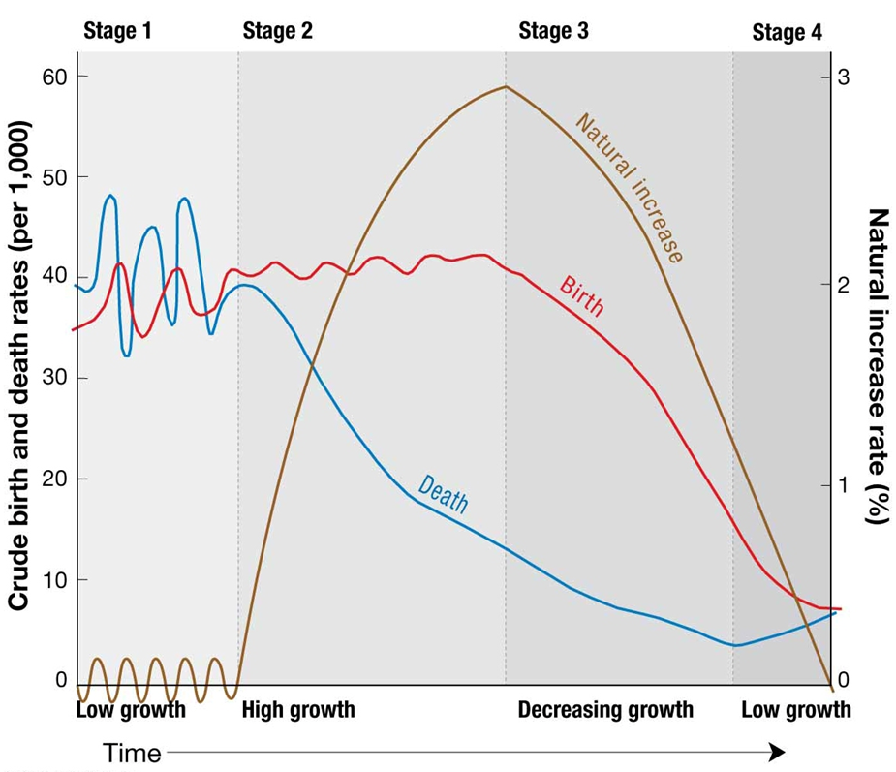
Population Growth
Population Structure
Fertility and mortality vary not only spatially but also temporally within a country.
A special bar graph known as a population pyramid can visually display a country’s distinctive population structure.
X-axis
Percent male displayed to the left of zero
Percent female displayed to the right of zero
Y-axis
Age cohorts typically grouped in 5-year intervals
Youngest displayed at bottom and oldest at top

Slide 12
Population Growth
The Demographic Transition
It is a model consisting of four stages that helps to explain the rising and falling of natural increase over time in a country.
Historically, no country has ever reverted back to a previous stage.
Thus, the model can be thought to have a beginning, middle, and an end.
A country’s stage of the demographic transition determines the percentage of people in different age groups.
The percentage of different age groups helps to understand a country’s distinctive challenges. (Health Care)

Slide 13
Population Growth: DMT Measurements
Dependency Ratio
Defined as the number of people who are too young or too old to work, compared to the number of people in their productive years.
People aged 0 to 14 and over 65 years old are considered dependents.
Larger dependency ratios imply greater financial burden on the working class.
85 percent in sub-Saharan Africa, while 47 percent in Europe.
Sex Ratio
Defined as the number of males per 100 females in the population
Developed countries have more females than males, because they tend to live 7 years longer.

Slide 14
The Demographic Transition Model

Slide 15
Population Growth
The Demographic Transition
Stage 4: Low Growth
Marked by very low birth and death rates
No long-term natural increase and possibly a decrease
Country reaches stage 4 when population gains by CBR are diminished by losses because of CDR.
Condition known as zero population growth (ZPG)
Demographers more precisely define ZPG as the TFR that produces no population change.
Population change results from immigration.

Slide 16
Population
Declining Birth Rates
Two Successful Strategies for Lowering Birth Rates
Improving Education and Health Care
CBR has gone from 27 to 20 since 1990
Emphasizes improving local economic conditions so that increased wealth is allocated to education and health programs seeking to lower birth rates.
More women able to attend school and then move into the workforce.
Women are understanding reproductive rights
Improved health care programs, improved prenatal care.

Slide 17
Population
2. Contraception
Diffusion of modern contraceptive methods
More immediate results reaped than previous approach
Met with greater resistance, because it goes against cultural or religious beliefs of some.
Bangladesh has had little improvement in wealth and literacy of its people but 56% of women use contraceptives compared to 2006, 6%
Roman Catholics, fundamentalist Protestants, Muslims, and Hindus
Colombia, Morocco and Thailand rapidly accepting family planning
Low contraceptive use in sub-Saharan Africa. 25%
2/3 China, 3/4 Latin America

Slide 18
Malthus on Overpopulation
Malthus on Overpopulation
He claimed the population was growing faster than the increase in food supply.
Malthus’s Critics
Many geographers consider his beliefs too pessimistic.
Malthus’s theory based on idea that world’s supply of resources is fixed rather than expanding.
Many disagree that population increase is not a problem.
Larger populations could stimulate economic growth, and therefore, production of more food.
Theory and Reality
Food production has increased over last 50 years faster than Malthus predicted.
His model predicted world population to quadruple over the course of 50 years.
Not even in India has population growth outpaced food production.

Slide 19
Demographic Transition Possible Stage 5: Decline
Demographic Transition Possible Stage 5: Decline
Characterized by…
Very low CBR
Increasing CDR
More elderly people than young persons
Negative NIR
Over time, few young women in child-bearing years
Contributing to ever falling CBR
Several European countries already have negative NIR.
Russia is most notable hosting a negative NIR for 50 years.

Slide 20
Population Health
Epidemiologic Transition
Medical researches have identified an epidemiologic transition that focuses on distinct health threats in each stage of the demographic transition.
Stage 1: Pestilence and Famine (High CDR)
Principal cause of death: infectious and parasitic diseases
Ex. black plague (bubonic plague)
Stage 2: Receding Pandemic (Rapidly Declining CDR)
Pandemic is a disease that occurs over a wide geographic area and affects a very high proportion of the population.
Factors that reduced spread of disease, during the industrial revolution
Improved sanitation
Improved nutrition
Improved medicine

Slide 21
Population Health
Epidemiologic Transition
Stage 3: Degenerative Diseases (Moderately Declining CDR)
Characterized by…
Decrease in deaths from infectious diseases.
Increase in chronic disorders associated with aging.
Cardiovascular diseases
Cancer
Stage 4: Delayed Degenerative Diseases (Low but Increasing CDR)
Characterized by…
Deaths caused by cardiovascular diseases and cancer delayed because of modern medicine treatments.
Infectious Diseases
Reasons for Possible Stage 5
Evolution
Infectious disease microbes evolve and establish a resistance to drugs and insecticides.
Antibiotics and genetic engineering contributes to the emergence of new strains of viruses and bacteria.
Poverty
Infectious diseases are more prevalent in poor areas because of presence of unsanitary conditions and inability to afford drugs needed for treatment.
Increased Connections
Advancements in modes of transportation, especially air travel, makes it easier for an individual infected in one country to be in another country before exhibiting symptoms.

Slide 22
Population Health
Health Care
Health conditions vary around the world, primarily, because countries possess different resources to care for people who are sick.
Expenditures on Health Care
More than 15 percent of total government expenditures in Europe and North America.
Less than 5 percent in sub-Saharan Africa and South Asia.
Health Care Systems
Developed Countries
Public service available at little or no cost.
Government pays more than 70 percent of health-care costs in most European countries, and private individuals pay about 30 percent of the expense.
Developing Countries
Private individuals must pay more than half of the cost of health care.
U.S. is an exception to these generalizations, because private individuals are required to pay about 55 percent of health care costs making it more closely resemble a developing country, in regards to health care.

