Slide 1
Chapter 4 Key Issue 4
Why do Folk and Popular Culture Face Sustainability Challenges?

Slide 2
Focus Questions 4-4
What challenges the sustainability of folk culture?
What impact has popular culture had on folk culture?
How has popular culture impacted the uniqueness of a place?
How has popular culture changed things for women?
Why is popular culture difficult to sustain?

Slide 3
A Threat to Folk Culture
Folk culture’s sustainability is threatened by the intrusion of popular culture, which threatens to change its character, draw away members, and lead to increased conflict within traditional societies.

Slide 4
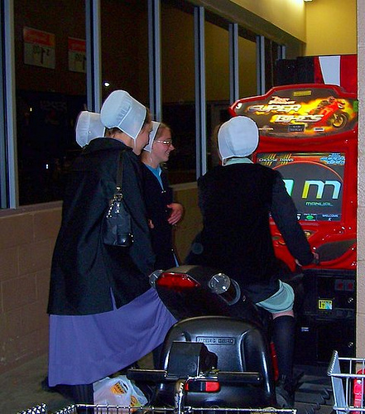
FOLK culture’s greatest challenge is the expansion of globalization and electronic media, which threaten its sustainability and unique character.

Slide 5
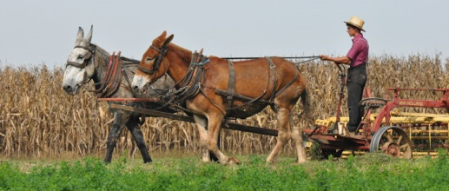
Sustainability Challenges for Folk Culture
Increased (and unavoidable) contact with popular culture makes maintaining centuries-old practices difficult.

Slide 6
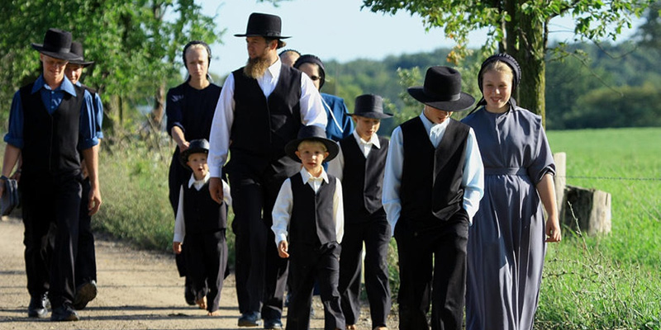
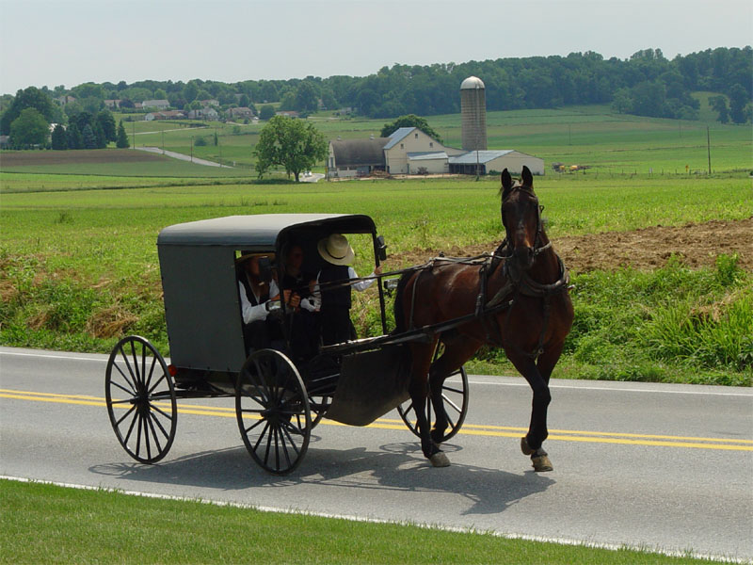
The AMISH
The AMISH are a religious and cultural group that have a very distinct way of living.
They shun modern conveniences, living a life of simplicity, community, and strong faith.

Slide 7
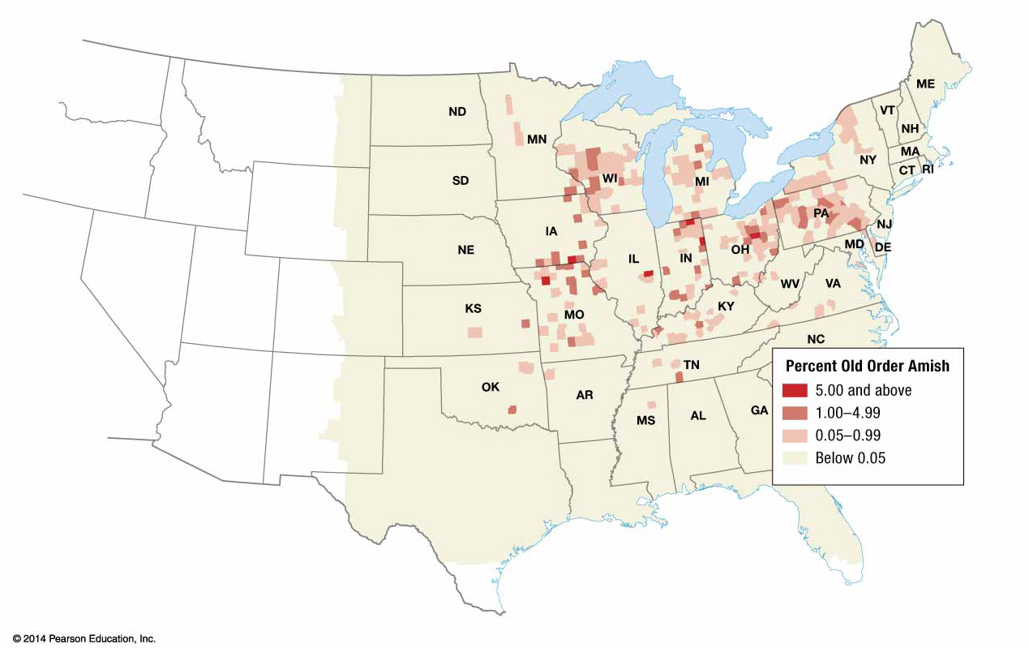
Approximately 250,000 Amish live in the United States today.
They migrated from Europe fleeing persecution in the 18th and 19th centuries.
They settled in rural counties where cheap land could be bought.

Slide 8
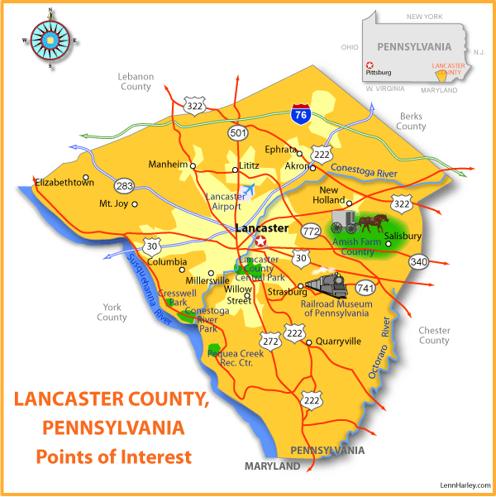
Lancaster County, PA hosts the nation’s oldest Amish community.

Slide 9
Lancaster Disappearing
Lancaster used to be the largest Amish community in the US, but it has been steadily shrinking since the mid-90s.
Proximity to cities like Philadelphia – and growing Lancaster itself- is driving up land prices in Lancaster County.
Many Amish are selling their Lancaster properties and movies to cheaper regions, like rural Kentucky.

Slide 10
RUMSPRINGA
When an Amish person turns 18, they are allowed to ‘run around,’ to experience the wider word; they then choose to return and commit to their faith, or not- to reject their lives and families and join the modern world.

Slide 11
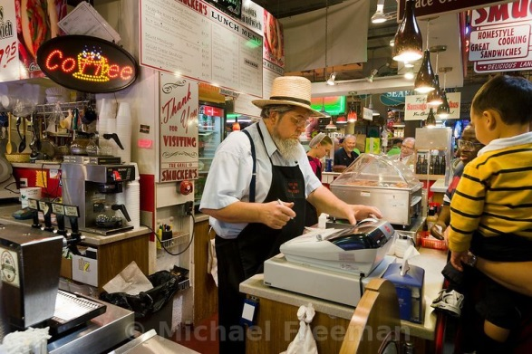

Slide 12
Global diffusion of popular cultural beliefs has challenged the subservience of women that is embedded in some folk customs.
Women in Folk Culture

Slide 13
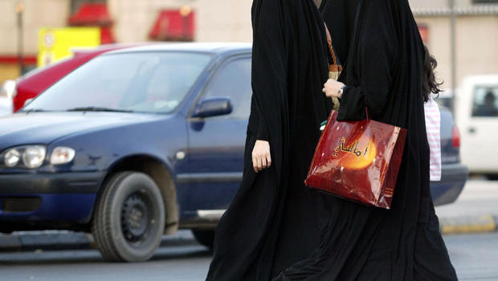
Gender roles are strictly reinforced in Saudi Arabia under its strict form of Islam
Women are limited in their opportunities, and must wear an all-covering garb. They are prohibited from driving alone without the accompaniment of a male relative.

Slide 14
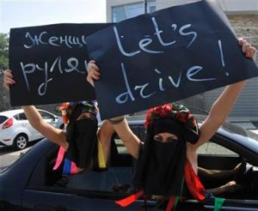

Slide 16
In some places, however, popular culture has made life harder for women.

Slide 17
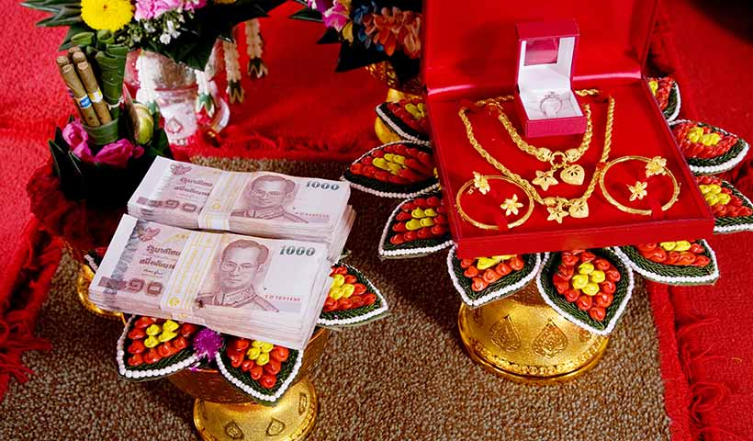
In India, a ‘DOWRY’ is a traditional part of a marriage.
Traditionally, the dowry was a small gift given from the bride’s family to the groom’s family. It was more symbolic than expensive.

Slide 18
Since the mid-twentieth century, dowries have grown exponentially as popular material culture has entered the picture.
Today, the families of many grooms will not accept a marriage unless a huge dowry was offered- often consisting of money and material items like cars, televisions, or computers.

Slide 19
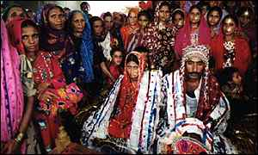
When a bride’s family cannot pay the promised dowry, she is often beaten or thrown out of the house- or in some cases, killed by being set ablaze.
This practice, called BRIDE BURNING, takes as many as 25,00 lives in India each year. It is illegal, but rarely reported in rural communities.

Slide 20
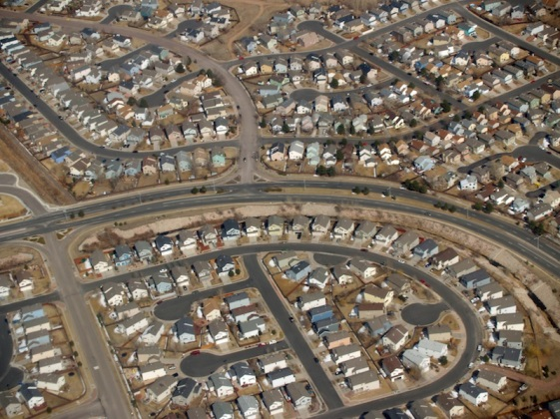
POPULAR culture’s greatest challenges come from its drive to produce uniform landscapes, high rate of consumption and depletion of resources

Slide 21
Sustainability Challenges for Popular Culture
While folk culture often emerges FROM the environment and is strongly influenced by it, popular culture is often separate from and imposed upon the landscape.

Slide 22
Popular cultures cause damage by extensively modifying the environment in order to produce UNIFORM LANDSCAPES.
Desirable features are reproduced in different locations, regardless of the effect on natural environments.

Slide 23
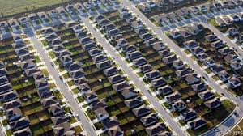
PLACELESSNESS- How popular cultural landscapes erase local identity, promoting the uniform over the unique.

Slide 24
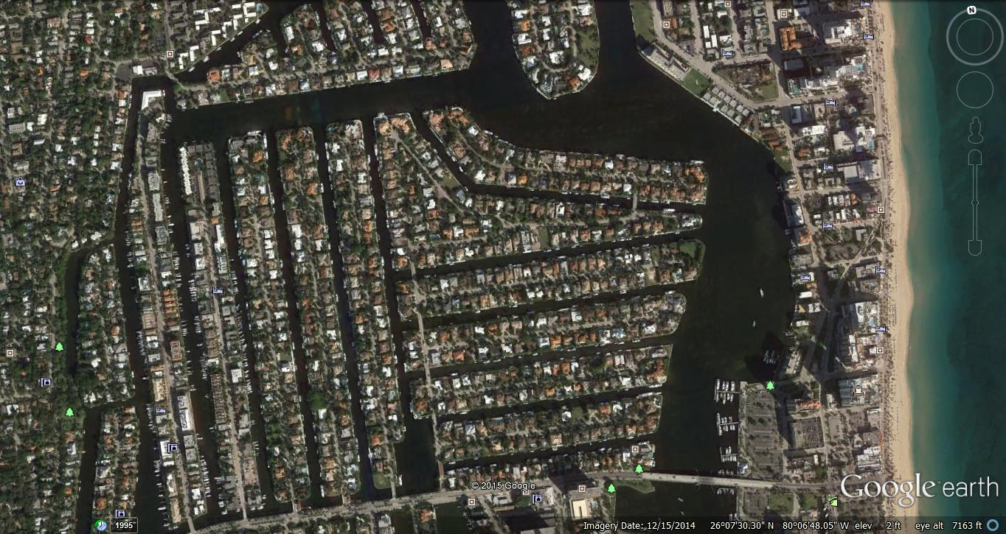

Slide 25
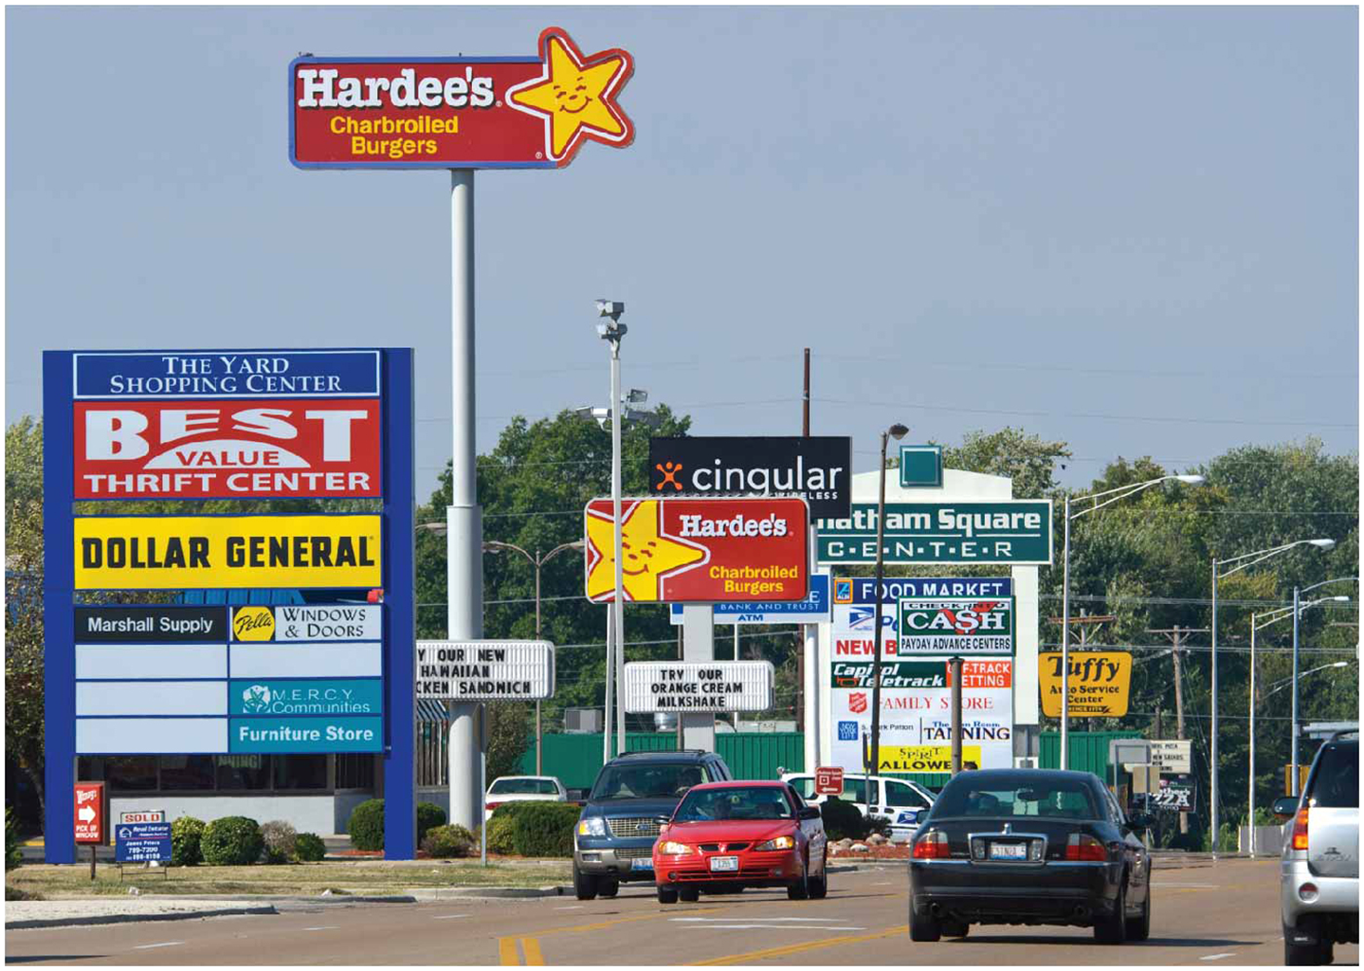
Uniform landscapes are used by companies to generate product recognition, leading to higher consumption.
People frequent businesses they are ‘familiar’ with.

Slide 26
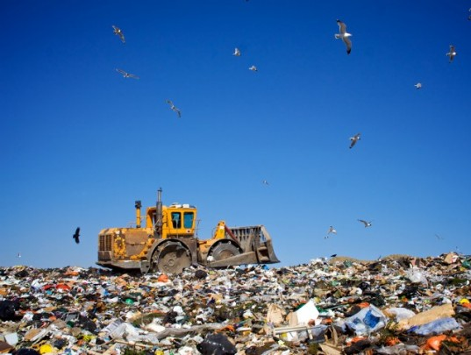
Popular culture promotes high levels of product and lifestyle consumption, which generates huge volumes of WASTE. Where folk cultures tend to produce little waste, popular culture has a USE-AND-DISCARD mentality.

Slide 27
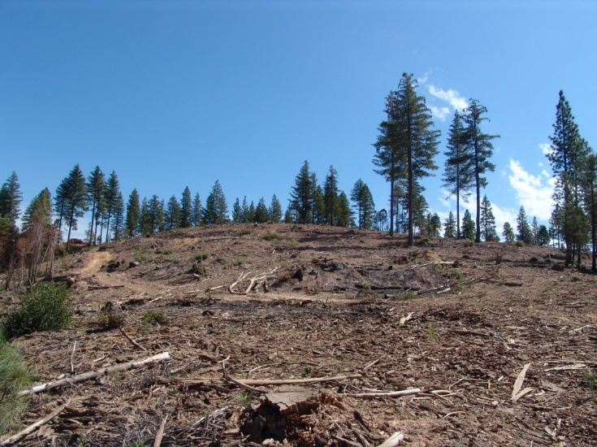
Popular culture places a great demand on natural resources of all kinds.
In order to sate popular material culture, many animals have been driven to near (or actual) extinction, and many natural resources are used unsustainably.

Slide 28
RECYCLING offers the developed world a chance to reduce its negative environmental impact. Recycled materials can be used to make new products, reducing DEMAND FOR NEW MATERIALS and WASTE PUT INTO LANDFILLS.
PAPER is the most easily recycled material; more than 63% of paper is recycled. It doesn’t have to be sorted!

Slide 29
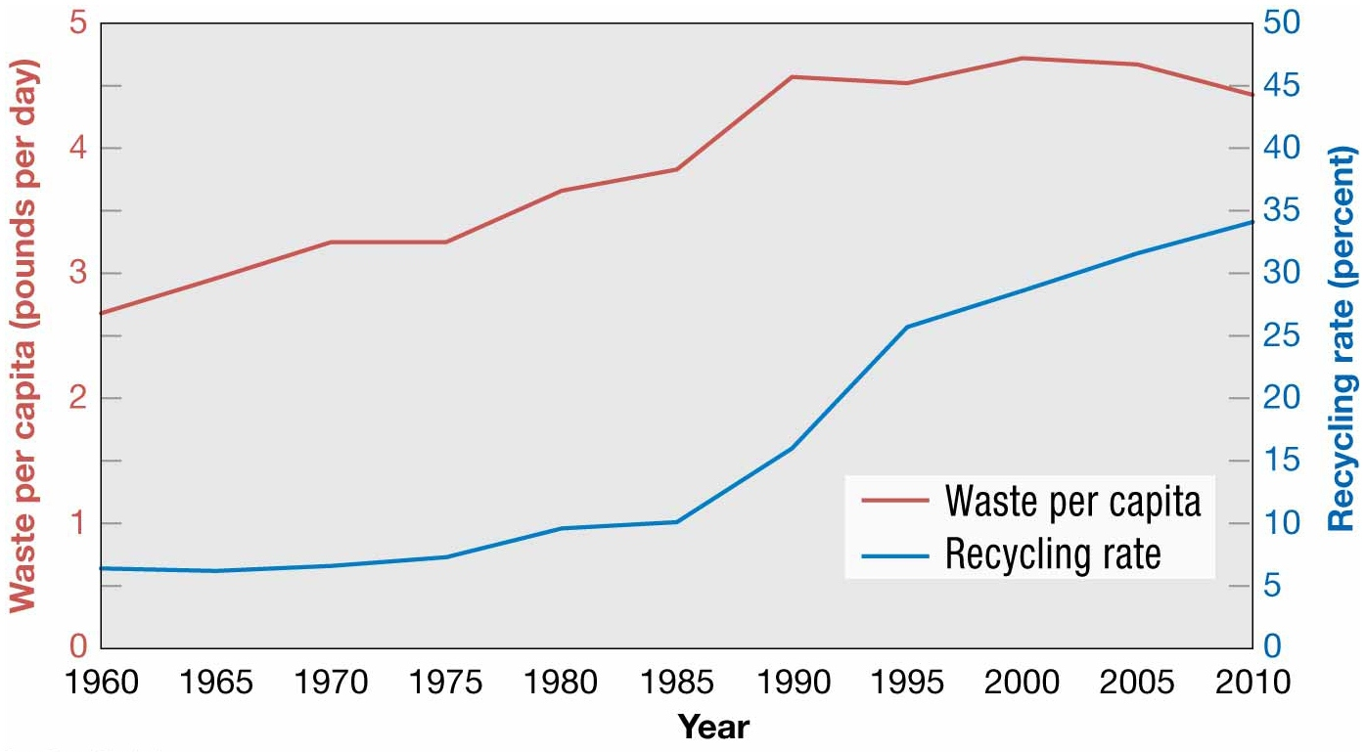
Notes:
FIGURE 4-45 RECYCLING IN THE UNITED STATES Recycling has increased substantially in the United States. As a result, the amount of waste generated per person has not changed much.

