Slide 1
Key Issue 4: Why Do Local Languages Survive?
1. What two competing geographic trends does language display?
2. What kinds of actions have nations and groups of people done to preserve language?
3. What are some examples of extinct languages?
4. What is the difference between an Isolated language and an unchanging language?
5. What has helped the language Hebrew survive and grow?

Slide 2
Language
The distribution of a language is a measure of the fate of a cultural group.
English has diffused around the world from a small island in northwestern Europe because of the dominance of England and the United States over other territory on Earth’s surface.
Language displays the two competing geographic trends of globalization and local diversity. (Survive or Extinction)
English has become the principal language of communication and interaction for the entire world.
At the same time, local languages endangered by the global dominance of English are being protected and preserved.

Slide 3
Endangered Languages
Many languages are threatened with extinction.
Ethnologue considers 2,447 of the world’s 7,102 languages to be endangered.
Varies in the UN 2,348 are in danger.
Reasons for endangered languages;
Childbearing generation is not capable of teaching language.
Fluent speakers are older and dying
- UNSECO 1,531-endangered
a. 598 considered vulnerable
b. 646 definitely endangered
c. 528 severely endangered
d. 528 critically endangered

Slide 4
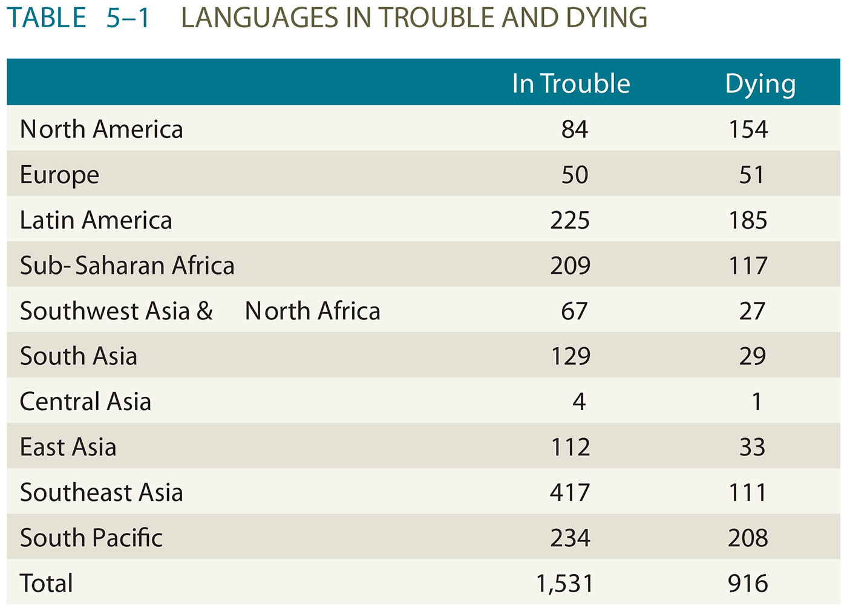
Languages in Trouble
Majority of these regions are dominated by only one widely used institutional language. Either English or Spanish.

Slide 5
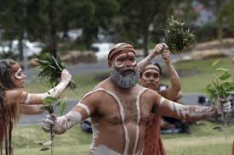
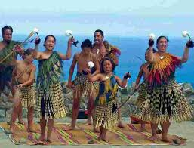
Endangered Languages in the South Pacific
British colonization during the early nineteenth century has allowed English to be the most widely used language in Australia and New Zealand.
In both these two places languages that predated British rule have survived.
Both countries have adopted different policies with regard to preserving indigenous languages.

Slide 6
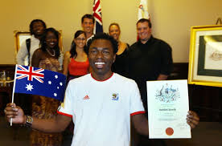
Australia and New Zealand
Australia had 211 living indigenous languages.
English is the primary language of instruction.
1% of the population is Aboriginal, but the country has made efforts in preserving their culture.
Prior though Australia established strict immigration polices that required English as entrance into the country.
Test were administered by immigration officers. In 1957 those test were eliminated.

Slide 7
Australia and New Zealand
14% of the population in New Zealand are descendants of the Polynesian people who migrated there about 1,000 years ago.
New Zealand has adopted policies to preserve the Maori language. It’s one of the 3 official languages in this countries.
The Ethnologue has classified Maori as an endangered language because of its older speaking population.
Unlike Australia, New Zealand has imposed a language requirement for immigrants.
Immigrants must already be fluent in English.
- Provides free English lessons
- Makes exceptions
- Few Asian immigrants

Slide 8
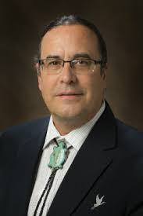
Endangered Languages in North America
United States has 61 languages in trouble and 142 languages dying, according to Ethnologue.
UN has different numbers, 25 definitely endangered, 35 severely endangered and 74 critically endangered languages.
The endangered languages were once spoken by large numbers of Native Americans.
Five endangered Native Languages are reawakening.
Myaamia; Darly Baldwin bilingual speaker, is teaching his children the language. First and only fluent speakers in the world.

Slide 9
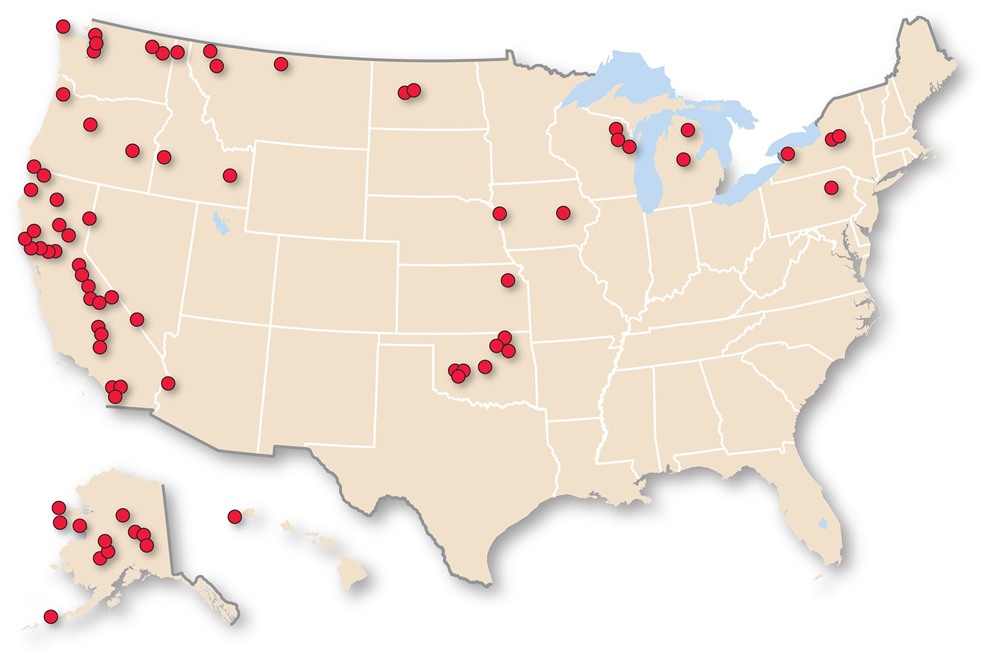
Critically Endangered U.S. Languages
Figure 5-38: Dots are located approximately where recently extinct languages were last spoken.

Slide 10
Preserving Languages
The US has had a program since 2003 that fights to preserve endangered languages.
The European Union has identified 60 local languages that people are trying to preserve.
Recent efforts have bolstered languages belonging to the Celtic-branch of the Indo-European.
Celtic languages give insights to the cultural heritage of places that now speak English.

Slide 11
Brythonic Celtic
The Celtic Branch is divided into Goidelic and Brythonic groups.
A 2014 census found 580,000 Welsh speakers in Wales, 23% of the population.
Wales is part of the UK, but is autonomous. 150,000 Welsh speakers have been identified in England as well.
In 1988 the Education Act made Welsh language training a compulsory subject in all schools. Schools added Welsh history and Music.
In 2011 the UK made Welsh an the official language of Wales.
All local governments and utility companies are obligated to provide services in Welsh.
BBC produces entertainment in the Welsh language.
73% on the census reported they had no Welsh language skills.

Slide 12
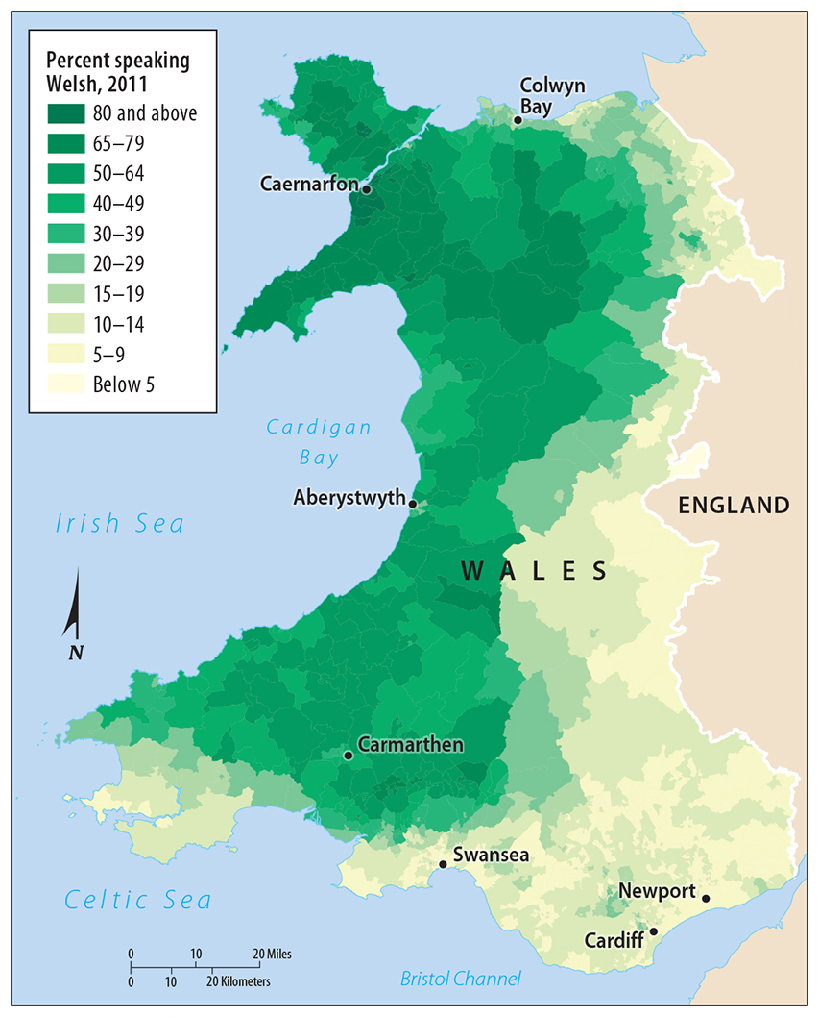
4.2 Welsh Language Distribution
Figure 5-40: Welsh becomes less spoken closer to the English-Wales border.

Slide 13
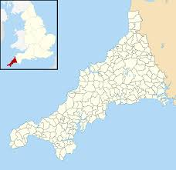
Cornish
The last know native speaker of Cornish died in 1777.
Cornish was revived in the 20th century.
In 2008 several Cornish language advocacy groups agreed to a standard system of writing.
In 2011 a census found 557 people in the UK claimed fluency in the language.
It is taught in grade school and adult evening courses and is used in some church services.

Slide 14
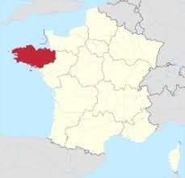
Breton
Brittany like Cornwall is an isolated peninsula that juts out into the Atlantic Ocean and is part of France.
The number of speakers has declined from around 1 million in 1950 to around 200,000 today.
¾ of the speakers are over the age of 65. Putting the language at risk.
French is required and is the principal language of instruction in school and government.

Slide 15
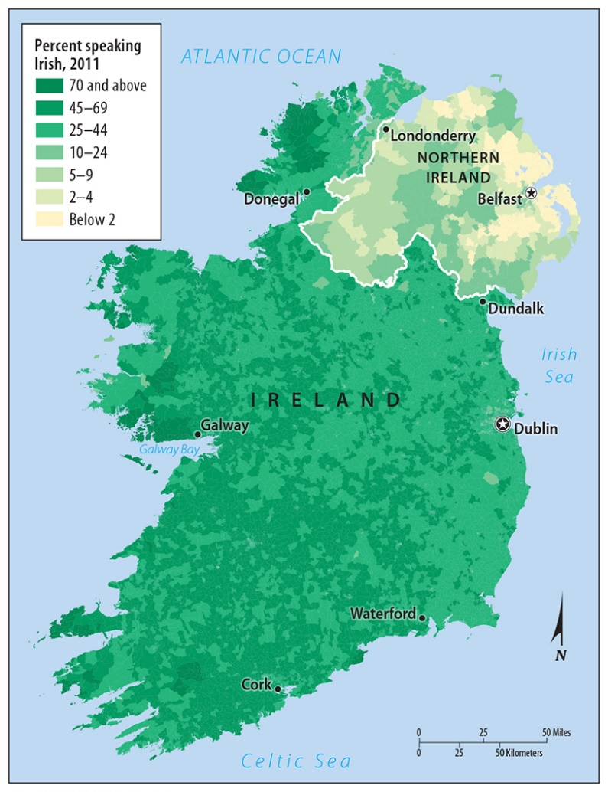
Irish Language Distribution
Irish is far less common in Northern Ireland than in Ireland. Remote areas have the highest proportion of Irish speakers.
In the 1300’s the Irish were forbidden to speak their own language in the presence of their English masters.
Today 1.3 million people say they speak Irish occasionally and 94,000 say they speak it daily.
Increase in use:
Street signs
Irish Rock
TV entertainment and broadcasting
The goal is to distinguish themselves from the English.

Slide 16
Isolated and Extinct Languages
Some languages bear no similarity to other languages. Isolation from others has helped to preserve some of these languages
An Isolated language is a language that is unrelated to any other and therefore not attached to any language family.
An isolated language arises because the speakers of that language have limited interaction with speakers of other languages.
Learned as a first language
6 out of 82 isolated languages are considered vigorous languages; more likely to survive, the others are in considered to be in danger
Example: Basque –Europe-Pyrenees Mountain N. of Spain

Slide 17
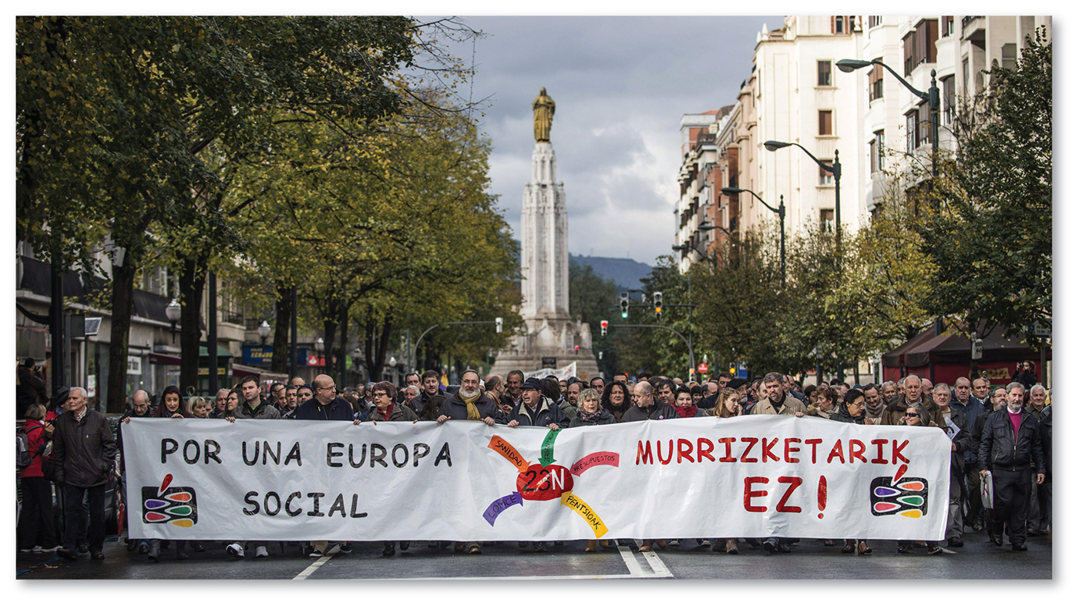
Basque: An Isolated Language
Figure 5-46: Basque is an isolated language considered vigorous because it is used in daily life.

Slide 18
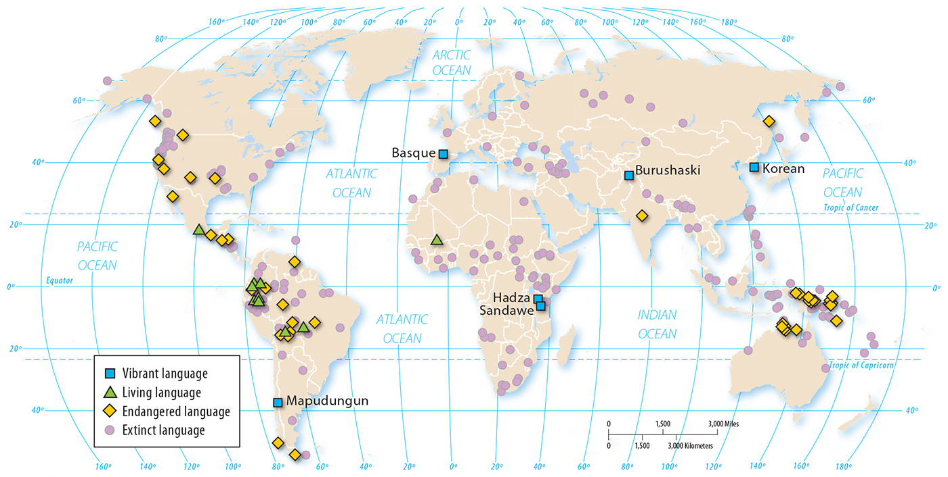
Isolated Languages
Figure 5-45: Isolated languages cannot be tied to any language families. Many isolated languages are endangered or have gone extinct.

Slide 19
Unchanging language
Icelandic is not an isolated language because it is in the North Germanic group of the Germanic Branch.
Icelandic is significant. Over the past 1,000 years it has changed less than any other language in the Germanic branch.
Icelandic speakers had very little contact with other speakers.
Less opportunities to learn new words.

Slide 20
Extinct Languages
Is a language that was once used by people in daily activities but is no longer in use.
367 languages have become extinct. A rate of 6 per year since 1950.
UN has identified 231 recently extinct languages.
Examples of extinct languages;
Liv-Uralic Family-Latvia-2013
Clallam-language spoken in Washington/Vancouver Island 2014
Peru-500 languages prior to Spanish Colonization-92 survived today.
US 74 languages now extinct, Native American Languages primarily from the West.
The loss of language is a reflection of globalization. To be part of a global economy and culture, people choose to use widely used language, leaving their traditional or indigenous language to disappear.

Slide 21
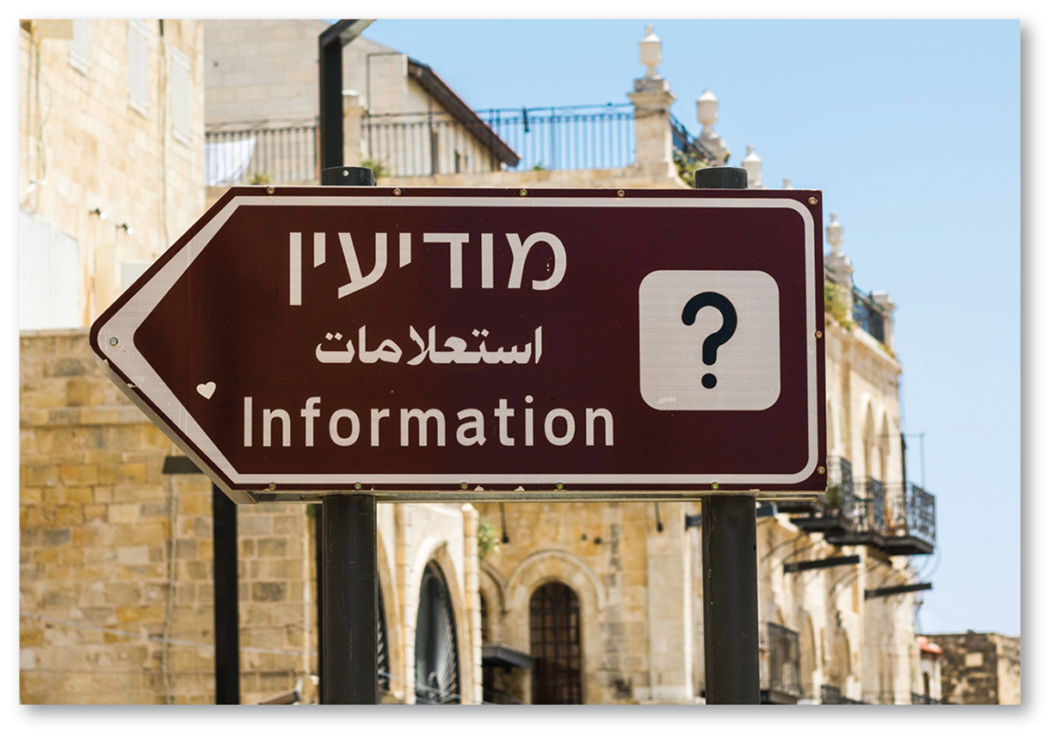
New and Growing Languages
Isolated languages continue to be identified and documented and entirely new languages are invented.
New language; India-Koro Aka 1,500 speakers in NE India.
Hebrew is an example of a language that was once rarely used but is more commonly used now.
Hebrew survived mainly because of the Bible and Christian Old Testament were written in Jewish.
The establishment of Israel as an independent country in 1948 and the adoption of both Arabic and Hebrew as the nations official languages helped preserve the language.
The revival efforts began with Eliezer Ben- Yehuda, he is credited for the invention of 4,000 new Hebrew words.

