Slide 1
Why Might Ethnicities Face Conflicts?
What is the difference between nationality and ethnicity?
Is Tiger Woods African American?
Why is ethnicity and nationality complicated in the UK?
Why is Nationalism both identified as a centripetal force and centrifugal force?
What are the reasons ethnicities face conflict?

Slide 2
Ethnicities and Nationalities: Canada
Nationality is the identity with a group of people who share legal attachment and personal allegiance to a particular country. Where they vote, where they perform civic duties, or where there passport is obtained
Ethnicity identifies groups with distinct ancestry and culture.
Ethnicity does not always correspond to nationality. Therefore sorting out ethnicity and nationality as a result is challenging.
In Canada the distinction between ethnicity and nationality is less clear and controversial.
Question: Is “Quebecois” a separate nationality from the English speaking parts of Canada?
The cultural differences can give the Quebec government a stronger case for independence.
1.Tension and conflict can occur when only one ethnicity is recognized nationally.

Slide 3
Canada

Slide 4
Ethnicities and Nationalities: US
United States: shared nationality by many different ethnicities
Tiger Woods: Nationality: American, Ethnicity: “Cablinasian”
Father: Mix of African American, Native American and possibly Chinese
Mother: Thai, Chinese, and Dutch
Mr. Aparicio: Nationality American
Ethnicity: Mexican/Hispanic
Race: Non-White (limited choices)
Father: Michoacán, Mexico
Mother: Mexico City, Mexico

Slide 5
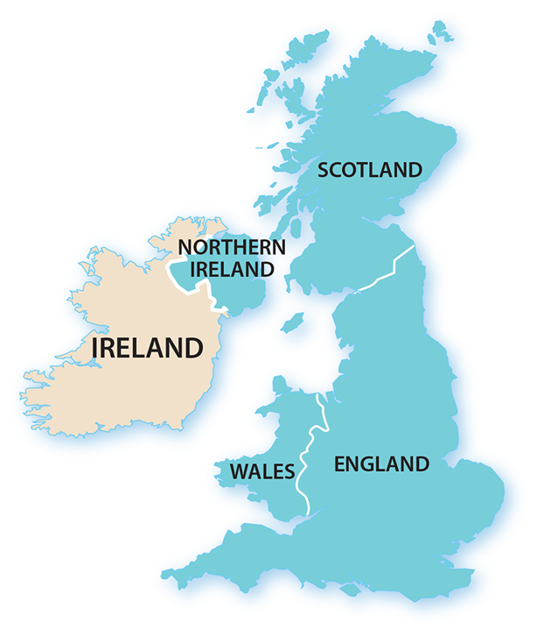
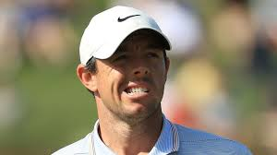
Ethnicities and Nationalities: UK
Most people in Ireland have an Irish ethnicity and nationality.
But the labeled ethnicities of the United Kingdom may also identify as their own nationalities instead of British.
Rory Mcllroy, a golfer identifies himself as an Irish National, and UK national. His ethnicity is Irish.
Ireland accepts as citizens anyone from Northern Ireland who so chooses to be part of The Republic.
Question? Does the UK contain one nationality or does it contain four nationalities; English, Scottish, Welsh and Irish?
Each of these places have governments with political authority.
Each territory fields a team during the World Cup
2. The structures and classifications within nations can create conflict.

Slide 6
Nationalism
Nationalism is the loyalty and devotion to a nationality. Nationalism typically promotes a sense of national consciousness that exalts one nation above all others and emphasizes its culture and interests as opposed to those of other nationalities.
People display nationalism by supporting a country that preserves and enhances the culture and attitudes of their nationality.
States foster nationalism by promoting symbols of the country, such as flags and songs.
Nationalism is an important example of a centripetal force, which is an attitude that tends to unify people and enhance support for a state.
3. Nationalism can also be a centrifugal force, which can do the opposite. Nationalism can divide people the same way in can unite them.

Slide 7
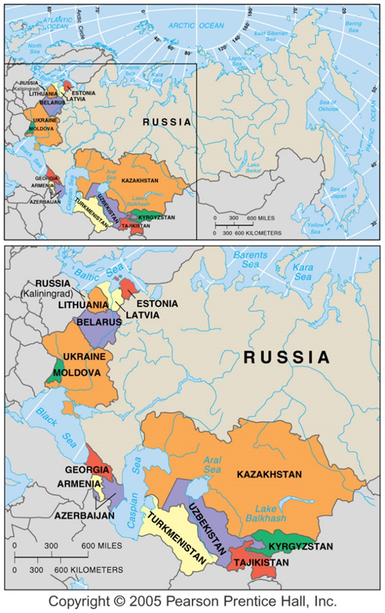
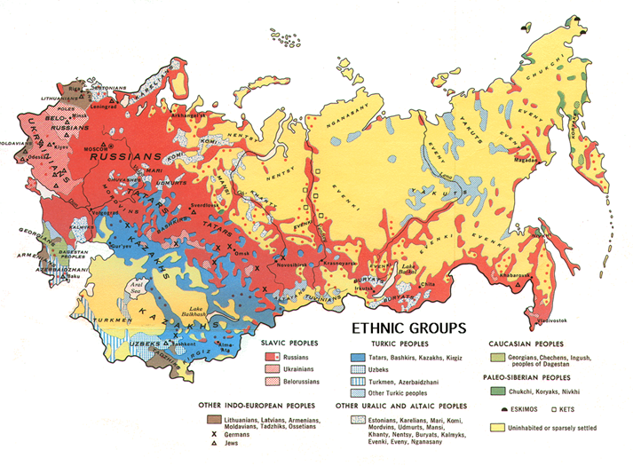
Republics of the Soviet Union
The Soviet Union was an especially prominent example of a multinational state until its collapse in the early 1990s.
The 15 republics that once constituted the Soviet Union are now independent countries.
When the Soviet Union existed, its 15 republics were based on the 15 largest ethnicities.
Less numerous ethnicities were not given the same level of recognition.
With the breakup a number of these less numerous ethnicities are now divided among more than one state.
Russia is an especially prominent example of a state with major difficulties in keeping all of its ethnicities contented.

Slide 8
Ethnicities in South Asia
India and Pakistan provide a vivid example of what happens when independence comes to colonies that contain two major ethnicities.
After British rule the country was divided into three separate countries. Pakistan, India and Bangladesh .
Hindu and Muslims had experienced tremendous tension and conflict between the two. Primarily over territory and religious tensions.
Gandhi argued and advocated for a single nation.
Mass migration in the late 1940’s, migrants were attacked by extremist on both sides.
4. The desire of a ethnic state after colonization and the actions of groups can create conflict with in ethnicities

Slide 9
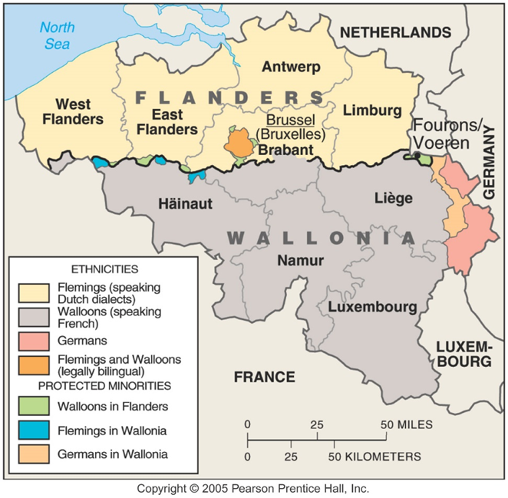
Example 1: Multinational States
In some multi-ethnic states, ethnicities all contribute cultural features to the formation of a single nationality.
Belgium is divided among the Dutch-speaking Flemish and the French-speaking Walloons.
Both groups consider themselves belonging to the Belgian nationality.
Other multi-ethnic states, known as multinational states, contain two ethnic groups with traditions of self-determination that agree to coexist peacefully by recognizing each other as distinct nationalities.

Slide 10
What are the reasons ethnicities face conflict?
1.Tension and conflict can occur when only one ethnicity is recognized nationally.
2. The structures and classifications within nations can create conflict.
3. Nationalism can also be a centrifugal force, which can do the opposite. Nationalism can divide people the same way in can unite them.
4. The desire of a ethnic state after colonization and the actions of groups can create conflict with in ethnicities

