Slide 1
Authority in the Dark Ages
Chapter 2 Section 1-2

Slide 2
Focus Questions 2-1-2
What two institutions had power during the Dark Ages?
What claims did both the King and the Pope make in regards to their right to rule?
What issue results of both the Kings and Popes claim?
What are three crisis that both the King and the Pope must face during this period?

Slide 3
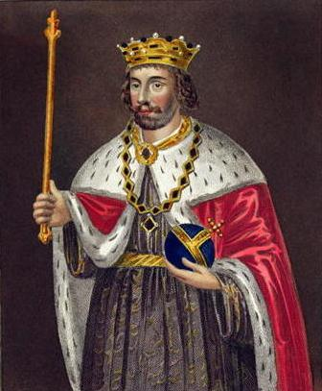
The Kings Authority
Medieval Kings claimed that their rule and authority came from God.
Divine Right of Kings gave the king power and authority over the land, resources, the laws, and over his people.
Wrote and enforced laws
Controlled and restricted the local economies
Influenced by a small group of advisors that represented the interest of the elite.
Required strict obedience
Commanded the militaries

Slide 4
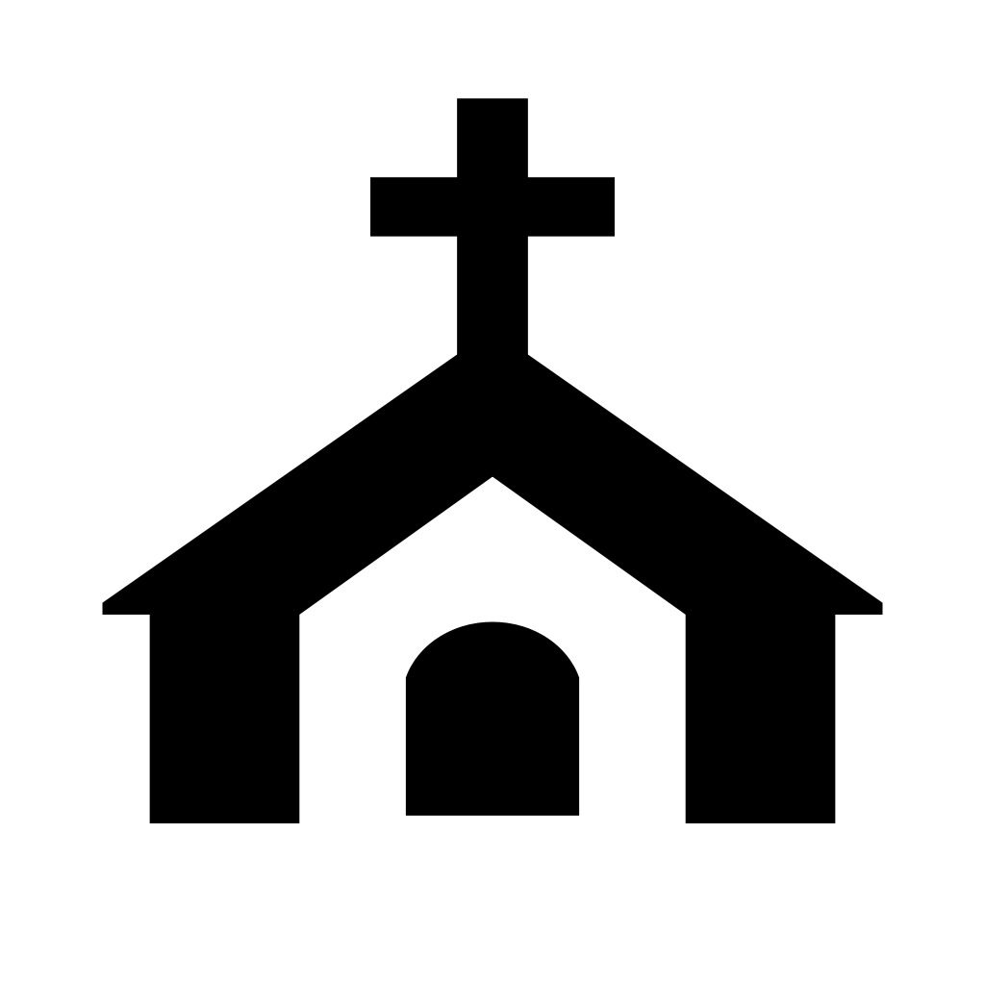
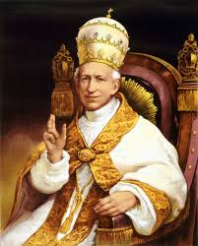
The Churches Authority
The Pope had all authority over the church in Europe.
Claimed to have Gods authority on earth.
Developed a system of authority within the church to maintain control. Priest, Bishops, Arch Bishops …..
All were under the authority of the Pope.
Laws were written to reflect biblical beliefs.
Church enforced laws as well and established punishments.
Required a 10% tithe from its members.
Church also provided protection.

Slide 5
Conflict between the Church and the king
As Feudalism developed it put power into the hands of many different lords, who came to constitute a powerful group of nobles dominating the political, economic, and social life of Europe.
As a result publicly the church was seen as the institution of authority, it was all embracing. But quietly the king and nobles gradually began to expand their power.
In some case kings fought against the Pope in order to have total control in their kingdoms.
Others worked with the Pope as a unified front to gain support from the people.
Society was divided, some supported the church, while others supported the authority of the King.

Slide 6
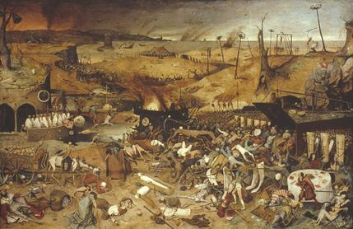
Crisis in the Dark Ages
There are several challenges that both the Church and King address during this period.
Disease; the Black plaque It reached Europe in the late 1340s, killing an estimated 25 million people.
Economic Depression; Food shortages and rapidly inflating prices were a fact of life for as much as a century before the plague.
Wheat, oats, hay and consequently livestock, were all in short supply.
Church oppression From birth to death, the life of the medieval people was dominated entirely by the church and many religious institutions gained power and wealth.
They were forbidden the right to their own property
They had to perform manual labour and follow the stringent regulations of the Church

Slide 7
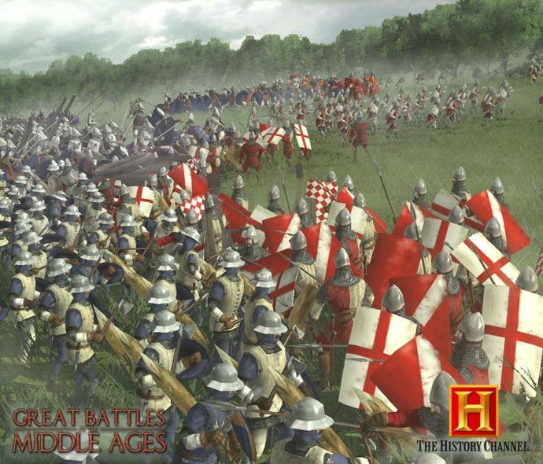
Crisis in the Dark Ages
Religious Conflict: This included Jews, Muslims and Pagans and Gypsies. Jews in fact suffered the most as they were considered to be the greatest threat to Christianity.
The Muslims were increasing their territory in fighting wars with Christian and Hindu rulers.
The Church very subtly played on the psychology of the common people by giving them assurance that their sins would be forgiven if they would fight for this “holy war” too. Thousands of innocent lives were taken in the name of religion.
The Crusades

