Slide 1
Focus Questions 1-1 p.2
1. What are the five concepts geographers focus on in order to describe where things are?
2. What is the difference between absolute and relative location?
3. Explain how time zones are defined?
4. How is distance important to the relationship between two places?
5. What are some examples of the new technology geographers use today and how does it help?

Slide 2
KEY ISSUE 1: Essential Question: HOW DO GEOGRAPHERS DESCRIBE WHERE THINGS ARE?

Slide 3
Geographers: Describing Where Things Are
When in it comes to the description of where things are geographers focus on the following concepts;
1. Space: refers to the physical gap or pause/ break between two objects.
2. Place: is a specific point or position on Earth, distinguished by a set of particular traits. Every place occupies a unique geographic location or position on the Earth’s surface. Site: can be described as the characteristics at the immediate location, for example structures, soil type, and climate. Situation: refers to the location of a place relative to its surroundings and other places. Ex: The Coachella can be found at the base of the San. Jacinto Mountains.
3. Region: is an area of Earth defined by one or more defining feature. EX: Midwest, Southwest regions of the US.
4.Scale: is the relationship between the portion of Earth being studied and Earth as a whole. (Large-Scale or Small Scale)
5.Connection: refers to relationships among people and objects across the barrier of space.

Slide 4
A Unique Place
The two basic concepts that are used by geographers to explain what makes a certain place unique is place and region.
Place: is a specific point or position on Earth, distinguished by a set of particular traits. Every place occupies a unique geographic location or position on the Earth’s surface. Region, Site and Situation help geographers describe the uniqueness of a place.
Region: is an area of Earth defined by one or more defining feature.
Characteristics of place:
-Physical place: natural features – what nature provides – climate, landforms, vegetation, etc.
-Human (cultural) place: features added by humans – distinctive dress, architecture, language, religion, burial practices, agricultural practices, etc.
-By describing a place you answer the question “What is it like there?”
-Geographers describe a place on Earth by identifying its location, the position that something occupies on Earth’s surface.
-A place has an absolute and a relative location.

Slide 5
A Unique Place
• Relative Location: is a description of where something is in relation to other things.
• It is often described in terms of connectivity; how well two locations are tied together, and accessibility; how quickly and easily people in one location can interact with people in another location.
EX: “I live near Date Palm and Vista Chino” or “I live two blocks south of the Palm Springs airport”

Slide 6
A Unique Place: Geographic Grid
Absolute location: is the precise spot where something is according to some system. (address, lot number)
The most widely used system is the Geographic Grid.
The Geographic Grid is a system of imaginary arcs drawn in grid pattern on Earth’s surface.
Any place on earth can be described using latitude and longitude (absolute location)

Slide 7
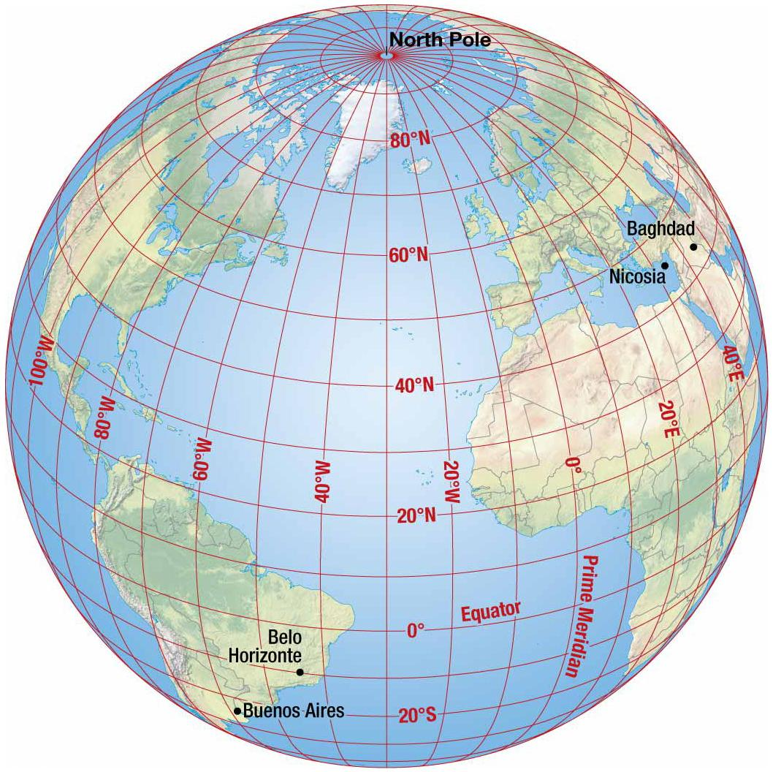
A Unique Place: Geographic Grid
Meridians – arcs drawn between North and South poles –Also known as lines of longitude
Parallels – circles drawn around the globe, parallel to the equator –Also known as lines of latitude
1. Prime Meridian: passes through Greenwich, England, and is 0 degrees longitude
2. International Date Line: is opposite the Prime Meridian and is 180 degrees longitude
–North and South poles are 90 degrees latitude
3. Equator is 0 degrees latitude (middle)

Slide 8
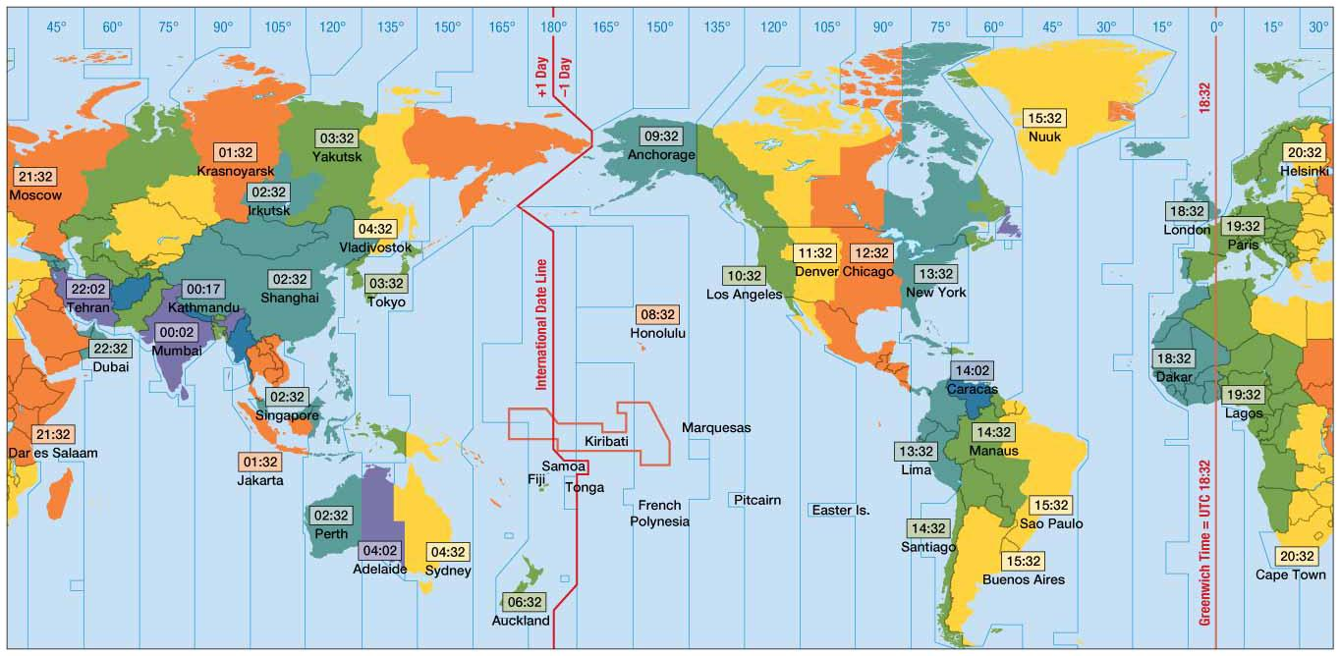
A Unique Place: Time Zones
Earth as a sphere is divided into 360º of longitude.
Divide 360º by 24 time zones (one for each hour of day) equals 15º.
Each 15º band of longitude is assigned to a standard time zone.
Greenwich Mean Time (GMT) –Located at the prime meridian (0º longitude).
Passes through Royal Observatory at Greenwich, England –Master reference time for all points on Earth

Slide 9
Geographers: Relationship Between Places
To explain the relationships between places, geographers employ three basic concepts: scale, space, and connection.
Scale is the relationship between the portion of Earth being studied and Earth as a whole.
Geographers study a variety of scales, from local to global.
Space refers to the physical or interval between two objects.
Connection refers to relationships among people and objects across the barrier of space.

Slide 10
Geographers: Relationship Between Places
Geographers: Relationship Between Places
In regards to connection geographers focus on distance to understand the connections between places.
Distance: is a measurement of how far or how near things are to one another. (Miles, feet etc)
-It’s an important part of geographic perspective and spatial approach.
Proximity: indicates the degree of nearness.
Time-Space Compression: is the “shrinking time distance between” locations because of improved methods of transportation and communication.
Friction of Distance: indicates that when things farther apart they tend to be less well connected.
Distance Decay: inverse of friction of distance, the close things are the more connected they are.

Slide 11
New Technology
Geographic Information Science involves the development and analysis of data about Earth acquired through satellite and other electronic information technologies.
Collecting Data: Remote Sensing: Acquisition of data about Earth’s surface from a satellite orbiting Earth or from other long distance methods is known as remote-sensing.
Global Positioning System (GPS)
System that accurately determines the precise position of something on Earth
GPS in the U.S. includes three elements
Satellites placed in predetermined orbits
Tracking stations to monitor and control satellites
Receivers that can locate at least four satellites, figure out its distance from each, and use the information to calculate its precise location

Slide 12
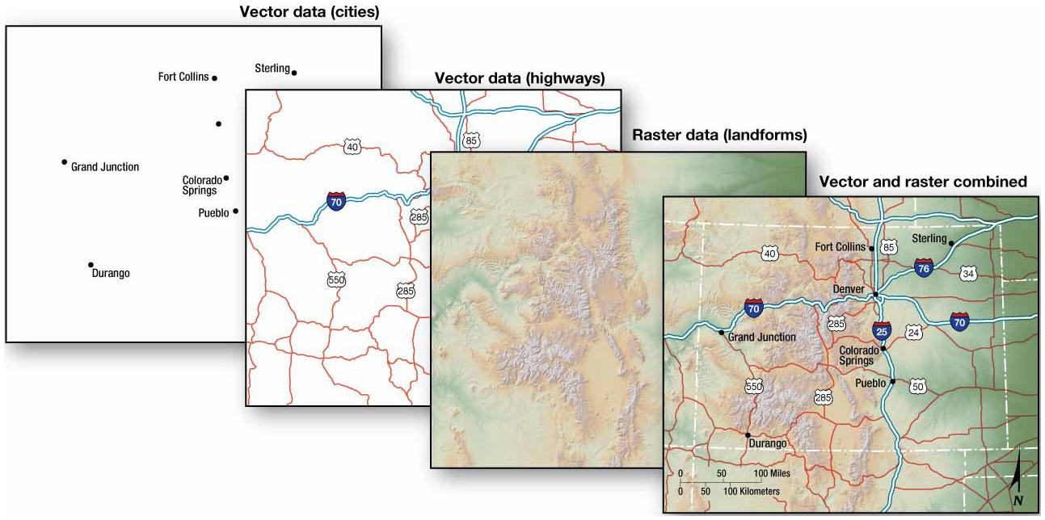
New Technology
Layering Data: GIS
A geographic information system (GIS) is a computer system that captures, stores, queries, analyzes, and displays geographic data.
Data are stored in layers.
Layers can be compared to show relationships among different kinds of information.
Data can be overlaid in one GIS from a variety of different sources through a process known as a mashup.

