Slide 1
Focus Questions 1-1-1/1-1-2
What is Geography the study of and what two important questions do they ask?
2. What two purposes do maps serve?
3. Identify at least three types of thematic maps geographers use.
4. What is the difference between a small-scale map and large scale map?

Slide 2
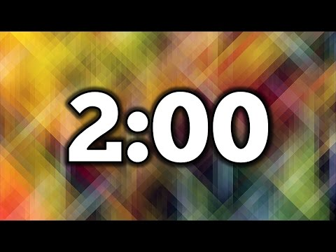
Warm up Discussion
What are somethings you do in your daily lives that involve geography?

Slide 3
Everything we do on a daily basis involves geography!
Foods we eat
Clothes we wear
Activities we enjoy
Schools we attend
Houses we live in
Jobs we do
Religions we practice
Languages we speak

Slide 4
Key Issues For Chapter 1
1. How do geographers describe where things are?
2. Why is each point on Earth unique?
3. Why are different places similar?
4. Why are some human actions not sustainable?

Slide 5
KEY ISSUE 1: Essential Question: HOW DO GEOGRAPHERS DESCRIBE WHERE THINGS ARE?

Slide 6
How Do Geographers Describe Where Things Are?
The word geography was invented by the ancient Greek scholar Eratosthenes.
Geography is the study of where things are found on Earth’s surface and the reasons for the locations.
Human geographers ask two simple questions…
Where are people and activities found on Earth?
Why are they found there?

Slide 7
Geography
Shares content with many other sciences.
( Climatologists, botanists, economists, sociologists)
Geography in a sense is a science of synthesis
Synthesis is the combination of ideas to form a theory or system.
What distinguishes geography from all other fields is that it focuses on a particular perspective, or way of looking at things, which leads to a spatial approach.

Slide 8
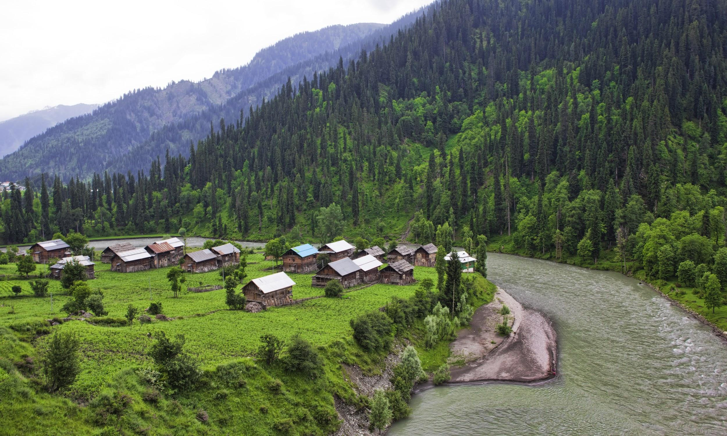
Spatial Approach
considers arrangements of the subject being studied.
they consider location, distance, orientation, pattern, and interconnection.
also looks at elements such as the movement of people and things, changes in places over time, and human perceptions of space and place

Slide 9
What’s the point?
Geographers seek out to answer important questions such as;
Why are things where they are?
How did things become distributed as they are?
What is changing the pattern of distribution?
What are the implications of the spatial distribution for people?

Slide 10
Spatial Approach in Action
Palm Springs 2019
Palm Springs early 2000’s

Slide 11
Geography
Referred to as the mother of all sciences, partly because it is one of the oldest fields of study.
Commonly divided into two major branches: 1. Physical Geography, is the study of spatial characteristics of various elements. (weather, climate, ecosystems, biomes, erosion…) 2. Human Geography, is the study of the spatial characteristics of humans and human activity.

Slide 12
Human Geographers
specialize in subfields
population, culture, economics, urban areas, and politics.
the degree of specialization in human geography reflects the wide interest of the geographers; there is medical geography, environmental geography, social geography…...etc

Slide 13
The tools of Geoprahers: Maps
Geography’s most important tool for thinking spatially about the distribution of features across Earth is a map.
A map is a two-dimensional or flat-scale model of Earth’s surface, or a portion of it.
Cartography is the science of mapmaking.
Maps serve two purposes…
As a reference tool to identify an object’s absolute and relative location.
As a communications tool to convey the distribution of human activities or physical features.

Slide 14
Types of Maps
Physical – show physical features such as lakes, deserts, mountains
Political – show boundaries and major cities
Thematic – colored, drawn, or labeled according to a certain theme
Cartogram
Choropleth
Dot density
Graduated symbol
Isoline

Slide 15
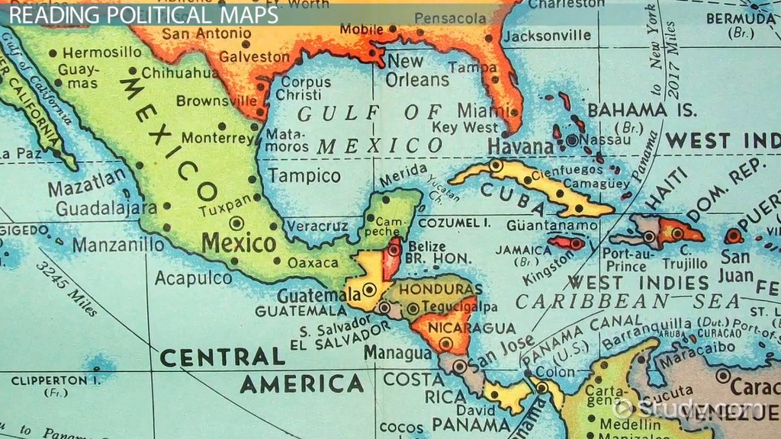
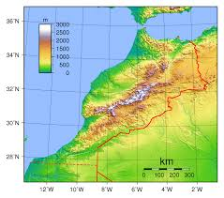
Examples of Physical and Political Maps
Political Map
Physical Map

Slide 16
Cartogram Map
Characteristics:
-Thematic; Population, GDP, Distance
-The geometry or space of the map is distorted.
- Conveys information in an alternate and variable manner.
-They are primarily used to display emphasis and for analysis

Slide 17
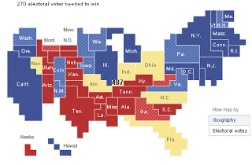
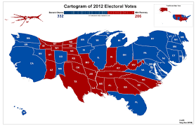
Cartogram Map

Slide 18
Choropleth Map
Characteristics:
-Is a thematic map
-Areas are shaded or patterned in proportion to the measurement of the statistical variable being displayed on the map.(Pop. GDP, Per-Capita)
-Choropleth maps provide an easy way to visualize how a measurement varies across a geographic area or show the level of variability within a region.

Slide 19
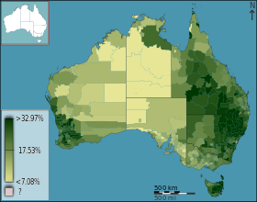
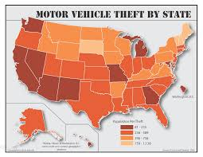
Choropleth Map

Slide 20
Dot Density Map
-Characteristics;
- thematic map
-Uses dots or other symbols on the map to show the values of one or more numeric data fields.
- Each dot on a dot-density map represents some amount of data.
-In a dot-density map, areas with many dots indicate high concentrations of values for the chosen field and fewer dots indicate lower concentrations.

Slide 21
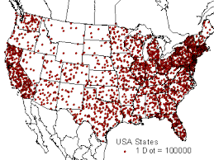
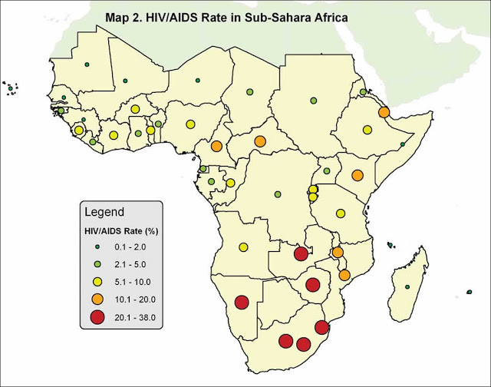
Dot Density Map

Slide 22
Graduated Symbol Map
-Characteristics;
-thematic mapping
-the cartographer selects a symbol and alters its size based on the data values

Slide 23
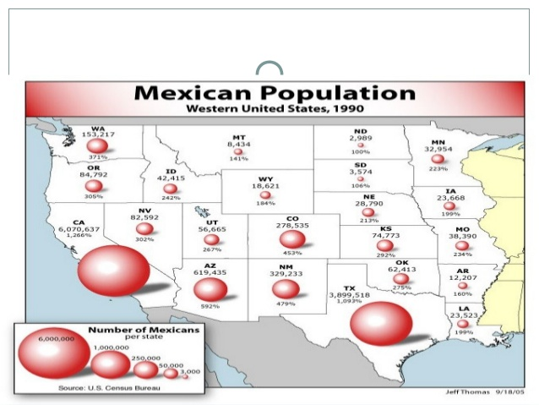
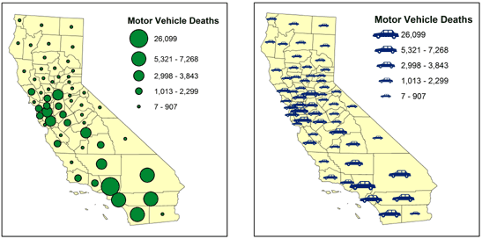
Graduated Symbol Map

Slide 24
Isoline Map
Characteristics;
-Thematic map
-There are different types of isoline maps.Contour lines, Isotherms, Isobars,Isotachs and Iso-seismal lines.
-connects points of equal value.
-Most commonly used to represent weather, and height.

Slide 25
Isoline Map

Slide 26
Map Scale
Level of detail and the amount of area covered on the map depend on its map scale.
Relationship of a features size on a map to its actual size on Earth
A small-scale map shows a smaller amount of detail for a larger area.
Ex: Map of United States
A large-scale map shows a larger amount of detail for a smaller area.
Ex: Map of the Coachella Valley
Notes:
26

Slide 27
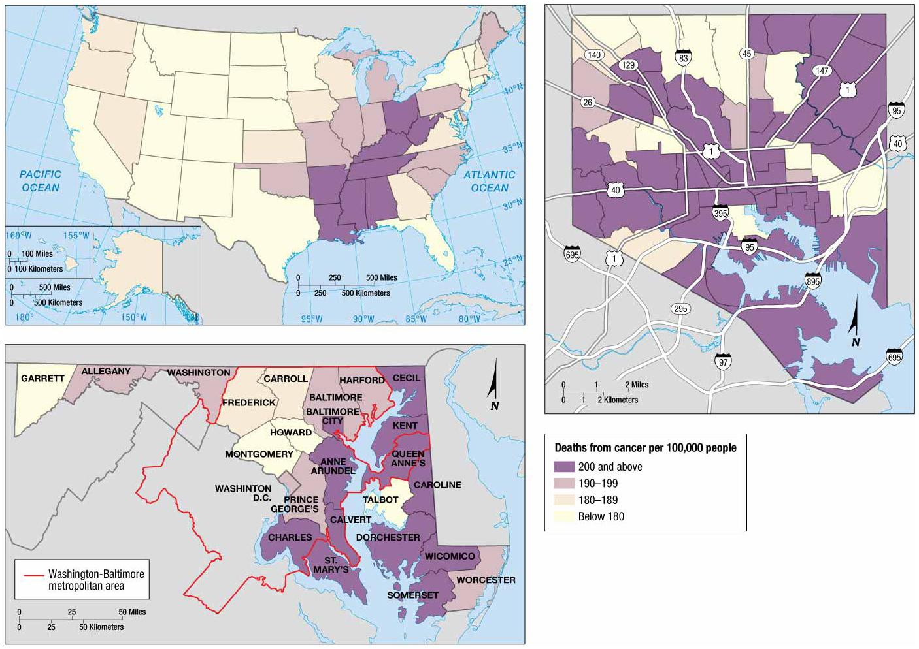
Spatialization of Cancer Rates

Slide 28
Projection
The scientific method of transferring locations on Earth’s surface to a flat map is called a projection.
Earth’s spherical shape causes distortion when drawing it on a flat piece of paper.
Four types of distortion
Shape of an area can be distorted.
Distance between points may become increased or decreased.
Relative size of different areas can be altered.
Direction between points can be distorted.

Slide 29
Mercator Projection
Shapes of countries are fairly accurate, direction is consistent
Greatly distorted toward poles

Slide 30
Robinson Projection
Allocates space to oceans
Land areas appear much smaller than they actually are

Slide 31
Peters Projection
“Equal area” map – all countries are the correct size
Shape is greatly distorted

Slide 32
Peters compared to Mercator

Slide 33
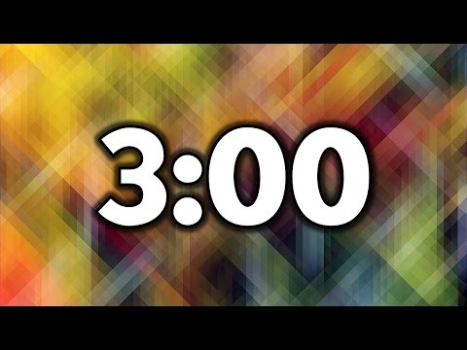
Discussion Question:
Should maps be accurate in the way they project information?
Maps that prove you don’t really know Earth
West Wing – Peters Projection

