Slide 1
Focus Questions 1-1-3/1-1-4
How does the Geographic Grid help geographers in regards to location?
How can we distinguish the Prime Meridian from the International Date Line
What is remote sensing, and how does it help us today?

Slide 2
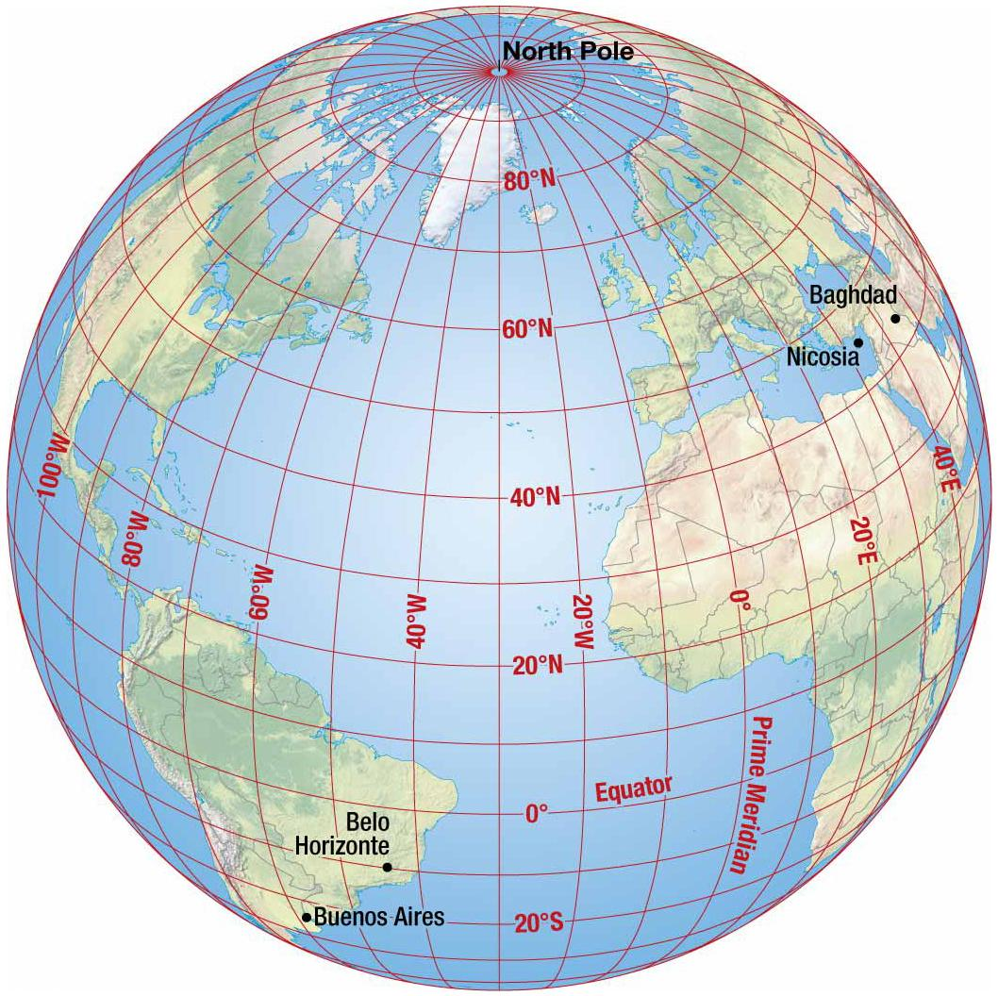
The Geographic Grid
The Geographic Grid is a system of imaginary arcs drawn in grid pattern on Earth’s surface.
Any place on earth can be described using latitude and longitude (absolute location)
Meridians – arcs drawn between North and South poles
Also known as lines of longitude
Prime Meridian passes through Greenwich, England, and is 0 degrees longitude
International Date Line is opposite the Prime Meridian and is 180 degrees longitude

Slide 3
The Geographic Grid
Parallels – circles drawn around the globe, parallel to the equator
Also known as lines of latitude
North and South poles are 90 degrees latitude
3. Equator is 0 degrees latitude (middle)

Slide 4
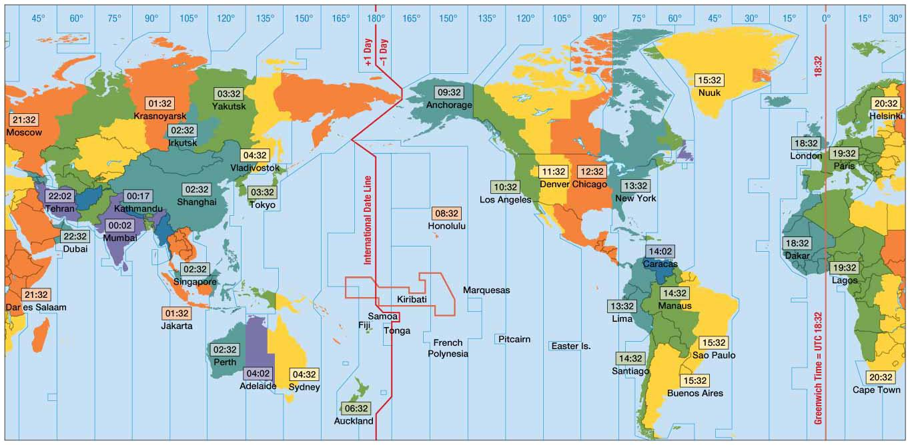
Time Zones
Earth as a sphere is divided into 360º of longitude.
Divide 360º by 24 time zones (one for each hour of day) equals 15º.
Each 15º band of longitude is assigned to a standard time zone.
Greenwich Mean Time (GMT)
Located at the prime meridian (0º longitude).
Passes through Royal Observatory at Greenwich, England
Master reference time for all points on Earth

Slide 5
Telling Time
The International Date Line is…
Located at 180º longitude.
Not a straight line!
Move the clock back 24 hours if you are heading eastward toward America.
Move the clock ahead 24 hours if you are heading westward toward Asia.

Slide 6
Telling Time
China has only one time zone but it should have five!
North Korea recently declared its own time zone
“Pyongyang time” – on its 70th anniversary of liberation from Japan
France has the most time zones, with 12
Russia has 11
United States has 11
United Kingdom has 9
Why so many?!

Slide 7
Contemporary Tools
Geographic Information Science involves the development and analysis of data about Earth acquired through satellite and other electronic information technologies.
Collecting Data: Remote Sensing
Acquisition of data about Earth’s surface from a satellite orbiting Earth or from other long distance methods is known as remote-sensing.

Slide 8
Contemporary Tools
Global Positioning System (GPS)
System that accurately determines the precise position of something on Earth
GPS in the U.S. includes three elements
Satellites placed in predetermined orbits
Tracking stations to monitor and control satellites
Receivers that can locate at least four satellites, figure out its distance from each, and use the information to calculate its precise location

Slide 9
Contemporary Tools
Layering Data: GIS
A geographic information system (GIS) is a computer system that captures, stores, queries, analyzes, and displays geographic data.
Data are stored in layers.
Layers can be compared to show relationships among different kinds of information.
Data can be overlaid in one GIS from a variety of different sources through a process known as a mashup.
Notes:
The word, geography, was invented by ancient Greek scholar, Eratosthenes.
Geo means earth
Graphy means to write.
Therefore, Geography can be thought of the discipline charged with the task to write about and to describe the phenomena spatially distributed on Earth.
9

Slide 10
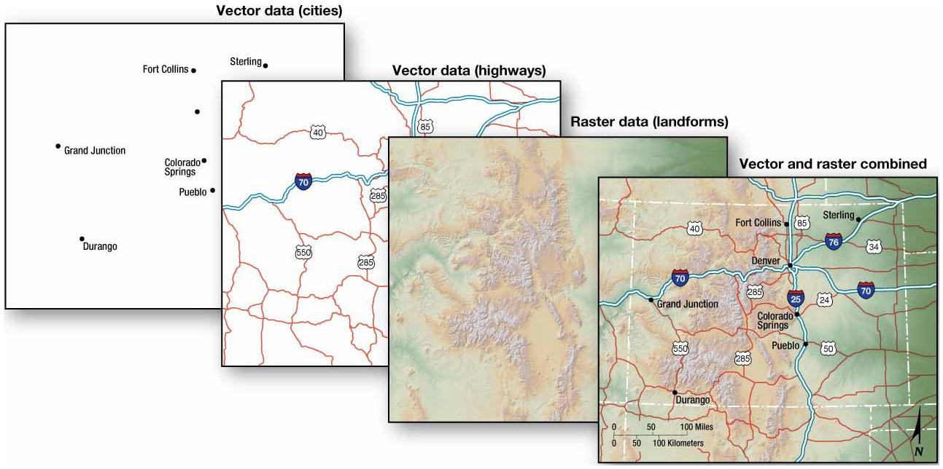
UWM’s GIS Page
Notes:
A map is an abstract representation of the Earth’s surface set to a scale that is accommodating to the user.
Maps help one to understand the reasons for the spatial distributions by comparing maps showing various features or activities.
10

