Slide 1
Focus Questions
What is stability and why is it important for societies/countries to maintain stability?
What are at least two factors for maintaining stability?
What are two underlying factors that leads to the loss of stability?
Today in our country which one of these factors is present? Provide an example
EQ: Why is stability so difficult to maintain?

Slide 2
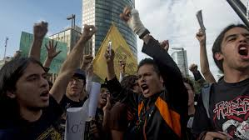
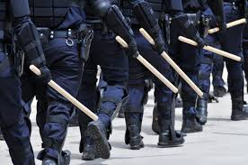
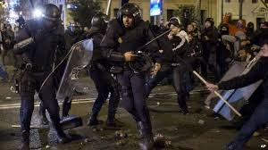
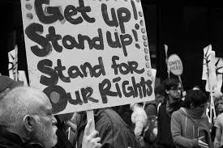
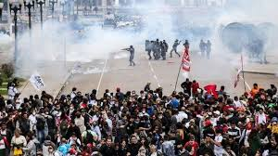
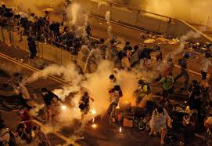
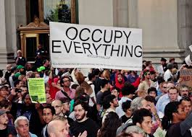
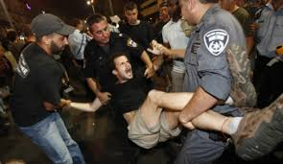
How does this happen?

Slide 3
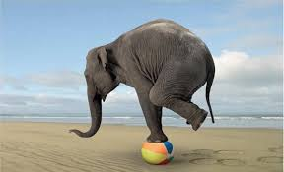
Stability
Stability is defined as;
the quality or state of something that is not easily changed or likely to change.
the quality or state of something that is not easily moved
*In essence stability is balance and security.

Slide 4
Factors of Stability
Access to Natural resources
Economic Structure
Shelter
A sense of Justice or rule by fear
Security

Slide 5
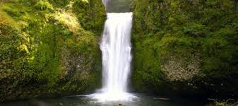
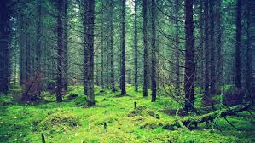
Natural Resources
Raw materials
Sometimes, natural resources can be used as raw materials to produce something. For instance, we can use a tree from the forest to produce timber. The timber is then used to produce wood for furniture or paper and paper products. In this scenario, the tree is the raw material.
Every item in your home was made from a raw material that came from a natural resource. The tea mug, electricity at home, bread, clothes, you name them: each of them came from a natural resource.
Natural resources come in many forms. It may be a solid, liquid or gas. It may also be organic or inorganic. It may also be metallic or non-metallic. It may be renewable or non-renewable.

Slide 6
Economic Structure
Economic structure is a term that describes the changing balance of output, trade, incomes and employment drawn from different economic sectors – ranging from primary farming, fishing, mining to secondary manufacturing and construction industries.
In simple terms how societies have access to income or individual wealth.

Slide 7
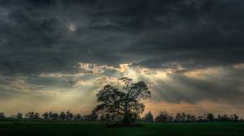
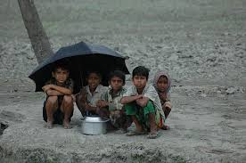
Shelter
a place giving temporary protection from bad weather or danger.

Slide 8
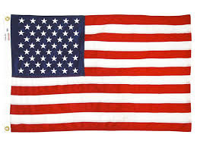
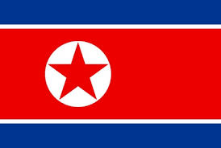
Justice or rule by fear
Rule through justice indicates a system that uses fairness as a means to control society.
Democracy in the US
Rule by fear is the use of fear as a means to rule over people.
North Korea

Slide 9
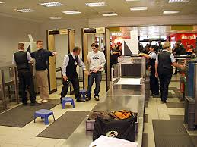
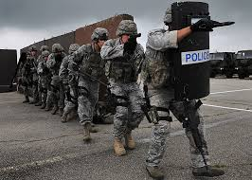
Security
the state of being free from danger or threat.
Being able to travel freely with out hesitation.

Slide 10
Underlying Factors
Trust: firm belief in the reliability, truth, ability, or strength of someone or something.
Confidence: the feeling or belief that one can rely on someone or something/the state of feeling certain about the truth of something.

