Slide 1
KEY ISSUE 2: WHY IS EACH POINT ON EARTH UNIQUE?
Define Place, and identify the two ways in which Geographers view place?
Geographers use location to help describe the uniqueness of a place, identify the three ways in which location can be identified?
What are some the examples that can be used to identify Place Name. (toponym)
What are the three types of regions? List and define them.
What two questions does culture help geographers answer?

Slide 2
Why Is Each Point on Earth Unique?
A place is a specific point on Earth distinguished by a particular characteristic.
Physical place: 1.natural features – what nature provides – climate, landforms, vegetation, etc.
Human (cultural) place: 1.– features added by humans – distinctive dress, architecture, language, religion, burial practices, agricultural practices, etc.
By describing a place you answer the question “What is it like there?”
Geographers describe a place on Earth by identifying its location, the position that something occupies on Earth’s surface.
A place has an absolute and a relative location.

Slide 3
Why Is Each Point on Earth Unique?
Location can be identified in three ways.
Place Name – a toponym is the name given to a place on Earth.
Names derived from people, religious affiliation, physical features, or origins of its settlers
Site - the physical character of a place.
Characteristics include climate, water sources, topography, soil, vegetation, and elevation.
Situation - the location of a place relative to other places.

Slide 4
7 Examples of toponyms
Descriptive - Rocky Mountains (Colorado)
Associative - Mill River, Springfield, Union Grove
Event Names - Battle Creek, Bloody Ridge
Commemorative - named after a person
Virginia, Louisiana, Constantinople, Bob Hope, Dean Martin
Commendatory - Pleasant Valley, Greenland
Mistaken - (historic errors in identification or translation) ex. West Indies
Shift Names (relocated names or names from settler's homeland)
Athens (Greece and Texas)-Palestine (Middle East and Texas)-New Mexico, New England

Slide 5
Why Is Each Point on Earth Unique?
The sense of place that humans possess may apply to a larger area of Earth rather than a specific place point.
Geographers use Region to group areas alike together.
Region: A Unique Area
An area on Earth defined by one or more distinctive characteristics is a region.
Regional patterns of language, religion, and ethnicity contribute to a sense of place and shape the global cultural landscape

Slide 6
Why Is Each Point on Earth Unique?
Geographers identify three types of regions:
Formal Region (aka uniform region or homogeneous region)
An area in which everyone shares in common one or more distinctive characteristics
Must be something measurable
Could be cultural (common language), economic (growing a certain crop), or environmental (same climate), political
Can be a state or a country with defined boundaries
Characteristic may be predominant rather than universal.
Notes:
First decision a cartographer faces is how much of Earth’s surface to depict on the map.
Ratio or Fraction scale- If you measure the distance between Point A and Point B as 1 inch, then their distance apart on Earth’s surface is 24,000 inches.
6

Slide 7
Formal Voting Regions

Slide 8
Why Is Each Point on Earth Unique?
Functional Region (aka nodal region)
An area organized around a node or focal point
The characteristic chosen to define a functional region dominates at a central focus or node and diminishes in importance outward.
Ex. Circulation of a newspaper, such as The New York Times
Ex. School district
Ex. School boundaries
Ex. Customer base for a shop or restaurant

Slide 9
Why Is Each Point on Earth Unique?
3. Vernacular Region (aka perceptual region)
An area that people believe exists as part of their cultural identity.
This is your “gut feeling” about an area
Ex. The American South
Ex. The Midwest
Ex. The Middle East

Slide 10
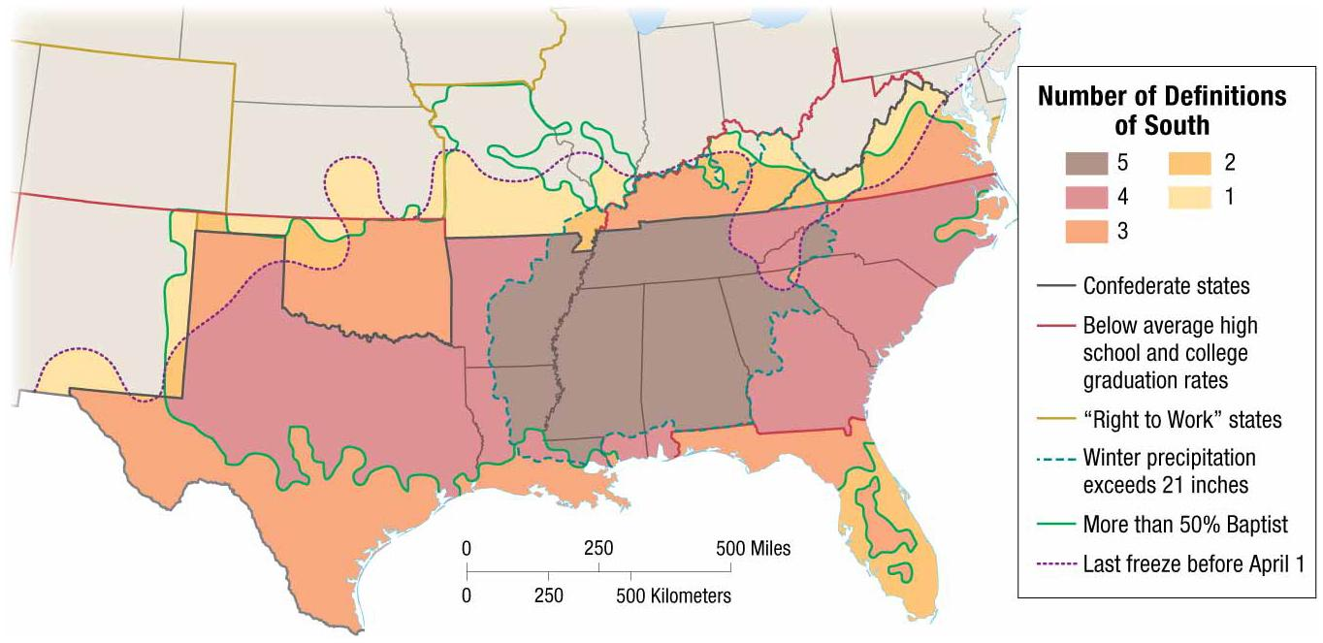
Examples of Vernacular Region

Slide 11
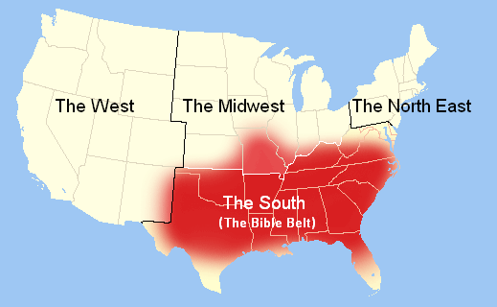
Examples of Vernacular Region

Slide 12
Culture
To understand why each region on Earth is distinctive geographers refer to Culture.
Culture is defined as the body of customary beliefs, material traits, and social forms that together constitute the distinct tradition of a group of people.
Culture helps answer two important questions for geographers in trying to understand a place uniqueness.
What people care about?
What people take care of?

Slide 13
Culture
What people care about?
Geographers study why the customary ideas, beliefs and values of a people produce a distinctive culture in a particular place.
Cultural values derive from three cultural traits
Language; is a system of signs and sounds gestures and marks that heave meaning.
Religion: principle system of attitudes, beliefs and practices through which people worship in a formal organized way.
Ethnicity: encompasses a group’s language, religion, cultural values and physical traits.

Slide 14
What people take care of?
The second element of culture of interest is the production of material wealth, food, clothing, and shelter.
Geographers divide the world into regions.
Developing Countries: engage in agriculture as a primary industry.
Developed Countries: perform jobs for wages and have various industries.
Measurements to distinguish one from the other; Per Capita, literacy rates, hospital beds, industry,

